Slide 1
Notes:
Part 3 of 4. This presentation covers the information required to complete PASS criteria of the LO3 Initial Expedition Training topic.
For best results, these instructor notes should be read in conjunction with this presentation and the lesson plan.
Handouts
Food Calories
Example Silver Expedition menu
Expedition Menu Ideas
Menu Planner
Expedition food Ideas
Stove safety instructions
Equipment
Filtration system
Chlorine tablets
Food in Food Calories handout
Ziplock bags
Plastic containers
Mess Tins
Camping Pots
Pocket rocket stove
Sqn gas stove
Gas stove with petzl igniter
Jetboil
Petrol stove
Trangia – meths burner
Op Ration Heater
Hexi Stove
Basecamp stove
Gas cannisters x 3
Meths x 2
Dragon Fuel/Gel
Petrol container
Hexi blocks
Metal mug x 1
Water bottle (full)

Slide 2
LEARNING OUTCOMES
LO3: Understand the principles of safe camp craft on an expedition.
Describe the principles of warmth and comfort in camp.
Notes:
LO3: Understand the principles of safe camp craft on an expedition.
P7: Describe the principles warmth and comfort in camp.

Slide 3
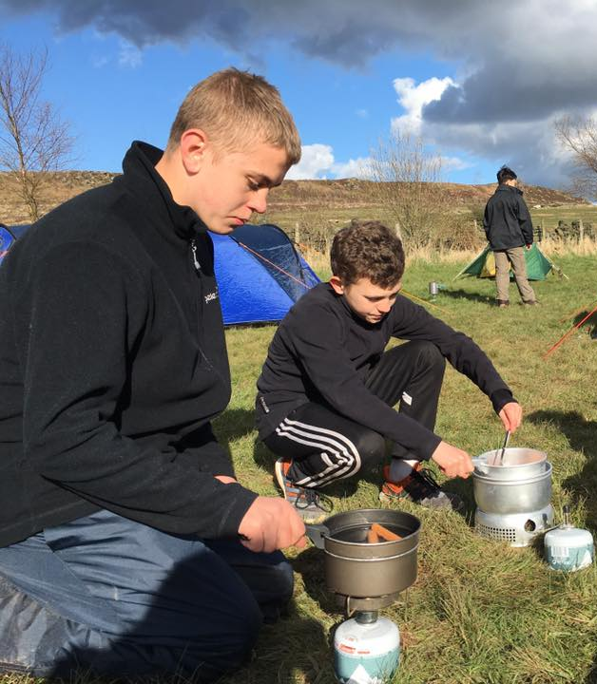
WARMTH AND COMFORT ON CAMP
Resource Book
Page 88
When you arrive at camp and have set up your tent:
Change out of wet clothing and put on dry socks.
Change your footwear if you have it.
Keep extra layers on – you have stopped walking and may feel colder now you aren’t exercising.
Have a hot drink if you aren’t ready for evening meal.
Notes:
You will get cold quickly if you are wet, so change as soon as possible.
Flip flops are ideal for camping – they are lightweight and dry easily.
Extra layers will be needed, even in summer.
If you are not having dinner for a few hours then have a hot drink or a Pot Noodle.

Slide 4
ANY QUESTIONS?
Are there any final questions?
?
Notes:
A chance to ask or answer any final questions.

Slide 5
LEARNING OUTCOMES
LO3: Understand the principles of safe camp craft on an expedition.
Describe the principles of warmth and comfort in camp.
Notes:
LO3: Understand the principles of safe camp craft on an expedition.
P7: Describe the principles warmth and comfort in camp.

Slide 6
WARMTH AND COMFORT TASK
Logbook
Page 34
Identify 4 things that can improve warmth or comfort on a campsite.
When this is complete your instructor should check and sign page 34 of your First Class Logbook.
Notes:
This task covers the mandatory requirement for objectives P7 for LO3.
Cadets must list four things to improve warmth and/or comfort on a campsite.
Once satisfied that all cadets have an understanding of the topic, instructors must check and sign:
Page 34 of the cadet’s first class log book.

Slide 7
LEARNING OUTCOMES
LO3: Understand the principles of safe camp craft on an expedition.
Describe the essentials of siting, pitching and striking a camp.
Notes:
LO3: Understand the principles of safe camp craft on an expedition.
P8: Describe the essentials of siting, pitching and striking a camp.

Slide 8
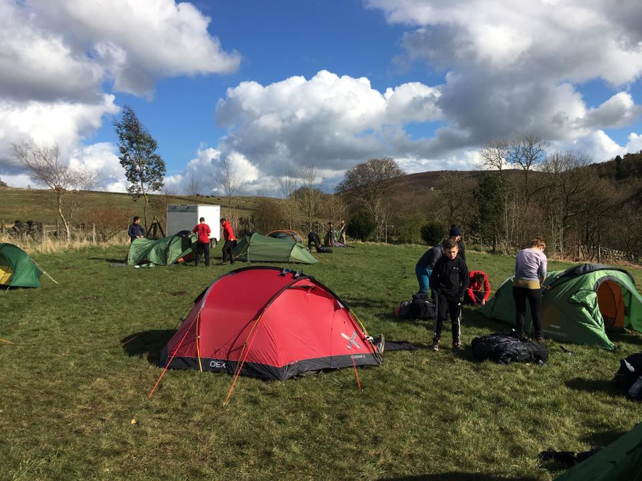
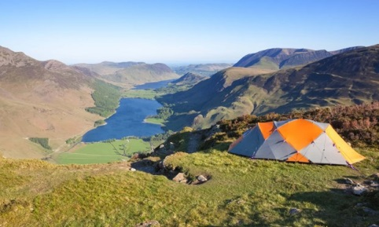
SITING YOUR CAMP
Resource Book
Page 87-88
Choose an area that is flat, well drained, safe from flooding.
Do not pitch your tent under a tree or close to water.
Shelter from the prevailing wind.
Safe water supply nearby.
If there are no toilets ensure you allocate appropriate toilet areas for male and female. Dig toilet holes.
When pitching tents ensure your tent is a good distance away from other tents.
Never place stones on top of guy lines, the sawing action of the wind will fray them.
Notes:
Choose an area that is flat (pitching on a slope will be uncomfortable). It should be well drained to ensure you aren’t flooded out.
Do not pitch your tent under a tree – branches may fall in high winds, which would demand the tent and possibly cause injury.
Do not pitch your tent close to water – in the event of heavy rain overnight this may flood.
Safe water should be nearby, but do not camp next to it.
(Wild camping) ensure you allocate appropriate toilet areas for male and female. Dig toilet holes.
When pitching tents ensure your tent is a good distance away from other tents (at least 5m – although this varies between sites).
Stones on top of guy lines will cause them to fray and break.

Slide 9
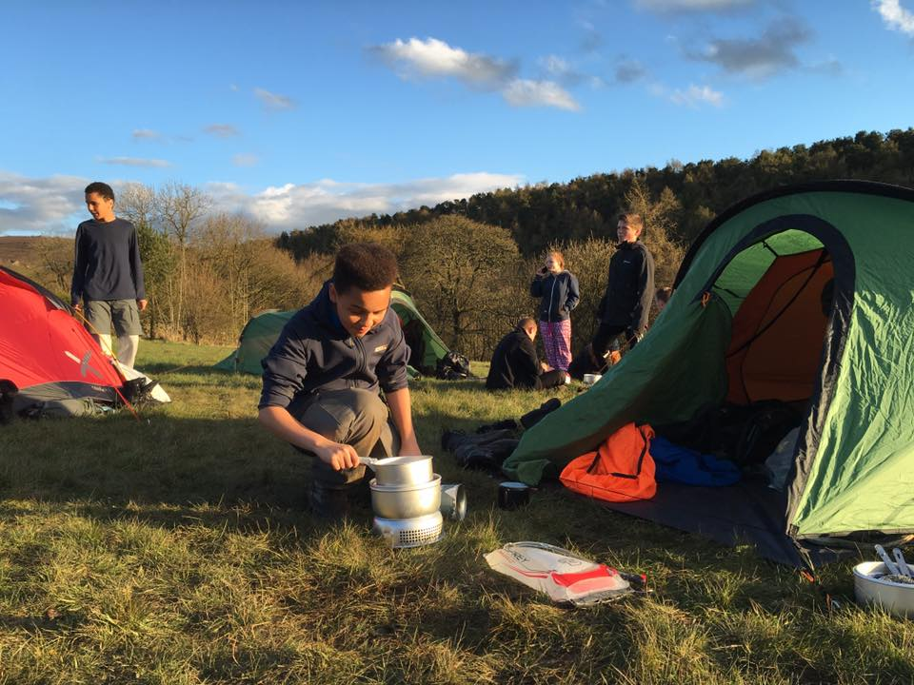
ON THE CAMPSITE
Resource Book
Page 88
Always put litter in a bin.
Make sure no food is left out overnight and keep the campsite and your tents tidy.
Keep noise to a minimum and respect other campsite users.
Do not light any campfires unless the campsite owner has given you permission.
Cook outside and never in tents. This is a real fire risk.
Notes:
Always put litter in a bin if there is one, or keep it with you until you find a bin or finish the expedition. Leaving litter can harm wildlife.
Make sure no food is left out overnight. This often attracts unwelcome wildlife in the middle of the night like foxes.
Keep the campsite and your tents tidy. Don’t leave equipment outside as it may get damaged or stolen by other campers.
Keep noise to a minimum and respect other campsite users.
Do not light any campfires unless the campsite owner has given you permission. If they have, be careful and follow all the sites safety rules. Ensure the fire is out before you go to bed.
Cook outside and never in tents. This is a real fire risk.

Slide 10
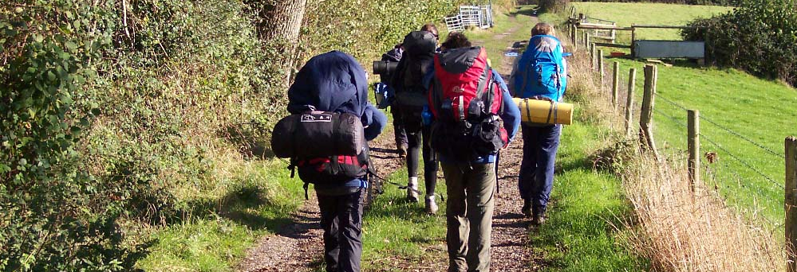
LEAVING THE CAMPSITE
Resource Book
Page 88
Pick up any rubbish, especially food waste and packaging.
Clean pegs.
When wild camping fill in toilet holes and burn any waste paper.
Pack outer sheet in a sperate waterproof bag if wet.
Check to make sure you haven’t left anything behind – leave the campsite in a better condition than when you found it!
Notes:
The only indication there should be that you were there is the flattened grass.

Slide 11
ANY QUESTIONS?
Are there any final questions?
?
Notes:
A chance to ask or answer any final questions.

Slide 12
LEARNING OUTCOMES
LO3: Understand the principles of safe camp craft on an expedition.
Describe the essentials of siting, pitching and striking a camp.
Notes:
LO3: Understand the principles of safe camp craft on an expedition.
P8: Describe the essentials of siting, pitching and striking a camp.

Slide 13
CAMPSITE TASK 1
Logbook
Page 35
Describe things to consider with siting, pitching and striking a camp.
When this is complete your instructor should check and sign page 35 of your First Class Logbook.
Notes:
This task covers the mandatory requirement for objectives P8 for LO3.
Cadets must list things to consider with siting, pitching and striking a camp.
Once satisfied that all cadets have an understanding of the topic, instructors must check and sign:
Page 35 of the cadet’s first class log book.

Slide 14
CAMPSITE TASK 2
Logbook
Page 35
Practice siting, pitching and striking a camp.
When this is complete your instructor should sign page 35 of your First Class Logbook and fill in the Task P8 Activity 2 Initial Expedition Training log sheet.
Notes:
This task covers the mandatory requirement for objectives P8 for LO3.
Cadets must demonstrate siting, pitching and striking a camp.
Once satisfied that all cadets have an understanding of the topic, instructors must fill in:
Page 35 of the cadet’s first class log book.
Task P8 Activity 2 log sheet. This can be found on Ultilearn.

Slide 15
LEARNING OUTCOMES
LO3: Understand the principles of safe camp craft on an expedition.
Explain food and cooking safety considerations for expeditions.
Notes:
LO3: Understand the principles of safe camp craft on an expedition.
P9: Explain food and cooking safety considerations for expeditions.

Slide 16
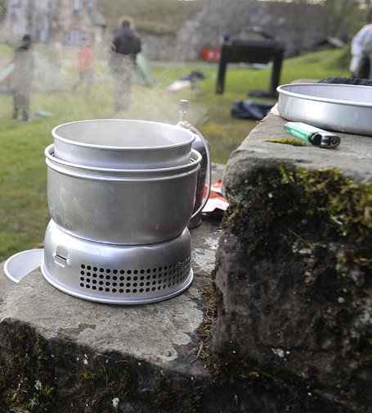
CHOOSING THE RIGHT FOOD
Your choices of expedition food are important, the fuel you put in your body is what will keep you going during long periods of walking.
Do not just buy pot noodles, super noodles etc, these do not provide sufficient energy to fuel you during expeditions.
Whatever you take needs to be suitable to cook on a camp stove or trangia.
Consider group cooking when planning an expedition.

Slide 17
EXPEDITION FOOD
Energy – calories
Weight – crucial on expeditions
Storage – no refrigeration on expeditions
Notes:
Factors to consider:
Does it have sufficient calories?
How much does it weigh?
Will it keep fresh?

Slide 18
CALORIE INTAKE
You need to consume enough calories every day in order to keep fit and healthy
1,700-2,000 for women and older adults
2,000-2,800 for men and active teenagers
You will need to increase this intake to 3,000-4,000 depending on how difficult the expedition is
Notes:
Your calorie intake needs to be a minimum of 3,000 per day.
Some guides say 4,000 calories but it is difficult to eat this much and your body has stores of calories that can be utilised for expeditions of less than a week.

Slide 19
DRINK
Don’t forget to drink during your activity or most of the energy will be lost
You need to drink a minimum of 2 litres of water a day to maintain a healthy body – much more in hot weather
You will need to eat after exercise too, the body needs to replace its glycogen to aid recover and repair muscles
Notes:
You need to drink throughout the expedition, if you don’t your performance will drop rapidly.
Minimum of 2 litres per day – more in hot temperatures.
Refill your water bottles whenever you can. Churches generally have outside taps.

Slide 20
CONSIDERATIONS
How much energy will the food give you?
Will you be able to cook it on the stoves you have?
How easy will it be to cook?
How long will it take to cook?
Does it need water?
How heavy is the food?
How bulky is it?
Is it breakable?
Will it go off?
Do you like it?
Can it be cooked for the whole group?
Notes:
You need at least 3,000 calories
You need to be able to cook it / heat it on your equipment
Needs to be easy and quick
If it needs rehydrating then remember to either carry more water or be near a water source
Think of weight and how much room it will take up in your rucksack
Do not carry glass containers
Fresh food will deteriorate quickly in your rucksack
There’s no point in taking food you don’t like – you won’t eat it and, therefore, won’t have the calories. This is not a survival situation – it is supposed to be enjoyable.
Coordination within the group will mean you can share the food and cook it all together rather than each individual cooking their own meal – this is a waste of time and gas.

Slide 21
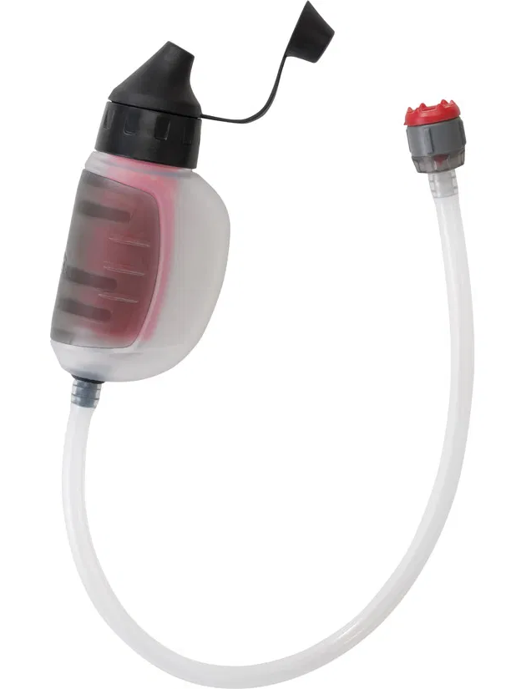
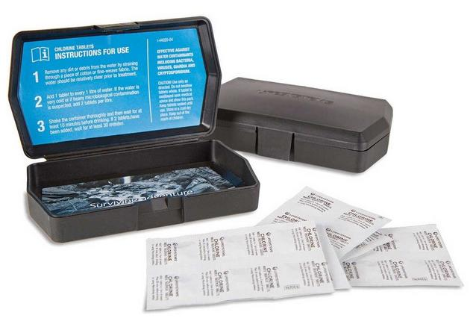
HYGIENE
Ensure hot food is cooked all the way through
Make sure you clean-up and wash-up after every meal
Check your water is safe to drink – don’t drink water straight from canals or steams
Boil for 10 minutes
Filtration device
Purifying tablets
Check the water container is clean
Notes:
Do not fill up from stream unless it is an emergency. Boil it or use filtration devices or chlorine tablets.
Show filtration system and chlorine tablets.

Slide 22
PERSONAL HYGIENE
Keep your wash kit in a waterproof bag/container
Keep your toilet roll in a separate waterproof bag
Only carry the essentials
Clean you hands with soap and water first if you can, then use antiseptic wipes or sanitiser.
Notes:
Wash the areas that get sweaty every day. Consider antibacterial underwear
Your ‘toilet kit’ needs to be separate from everything and should be easily accessible. It should contain:
Toilet paper
Hand sanitizer
Matches / lighter
The group should have a lightweight trowel to dig a hole. If it is not possible to dig a hole then you will need to bag it and take it with you until you can dispose of it.

Slide 23
MENU
Breakfast
Lunch
Snacks
Evening
Pudding (optional)
Emergency
Notes:
You need food that covers the three main meals, snacks to maintain energy, and emergency food.
You may want to consider having food that doesn’t need cooking/heating for lunch. If you are behind schedule or the weather conditions are bad you will not want to stop and get your stove out.
Emergency rations are something to give a quick energy boost if needed, i.e. a Snickers bar or Kendal Mint Cake.
Handout:
Expedition Menu Ideas
Example Silver Expedition menu
Menu Planner

Slide 24
FOOD CONSTITUENTS
Protein – builds and repairs tissues
Fats – energy, absorb vitamins, produce chemicals
Carbohydrates – energy, fibre
Notes:
You can’t just eat 3,000 calories worth of biscuits – they do not have the constituents that your body needs:
Protein, fat, and carbohydrates

Slide 25
SPECIALIST OR SHOP BOUGHT?
Easier and quicker to cook but more expensive
Slower and harder to cook but less expensive
Notes:
It makes no difference whether you buy the specialist meals or buy the separate ingredients from a shop. What is important is that they have the necessary proteins, fats, and carbohydrates.
Boil in the bags are quicker and easier but they cost more.
Handout:
Expedition Food Ideas
Food Calories
Equipment
Using Food Calories handout, show suggested food and individual serving size

Slide 26
SPECIALIST OR SHOP BOUGHT?
No cans or glass jars
Use zip-lock plastic bags / plastic containers
Empty cans into a plastic container
Notes:
Compare good vs bad, i.e. boil in the bag vs cans/glass jar.
Equipment:
Ziplock Bags
Plastic containers

Slide 27
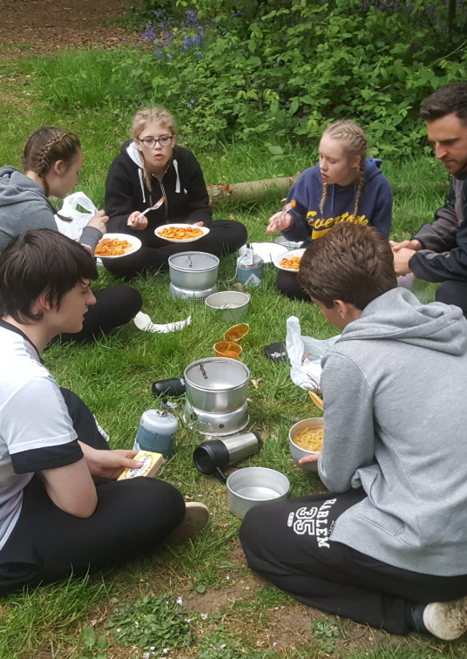
FOOD DO’S
Choose filling foods with plenty of carbohydrates, for example pasta or rice.
Plan your meals beforehand and take snacks to keep your energy levels up throughout the day.
Make sure you take sufficient breakfasts to provide you with energy throughout the day.
Consider how you are going to cook the meals you are taking.

Slide 28
FOOD DON’TS
Don’t take raw meat, you have no way of storing it safely and are likely to make yourself ill.
Don’t take pot noodles and similar snacks as main meals – they do not contain enough energy.
Don’t just eat chocolate and sweets, these provide short term energy only, and not the energy required to keep you going all day.

Slide 29
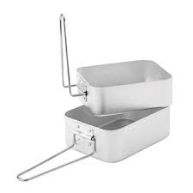
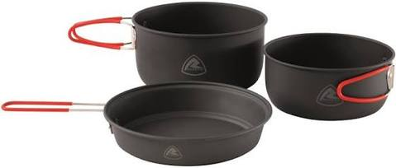
COOKING
Notes:
How are you going to cook it?
Show how to use.
Large mess tin over small mess tin
Cover on pots
Equipment:
Mess Tins
Camping Pots

Slide 30
COOKING SAFETY CONSIDERATIONS
Resource Book
Page 89
Never cook in your tent, this produces a build up of carbon monoxide that will kill you.
Never cook close to your tent – you may set it on fire.
Never play games or fool around while cooking.

Slide 31
COOKING SAFETY CONSIDERATIONS
Resource Book
Page 89
Always take care when moving hot pans and food.
Always ensure you know how to safely operate the stove you are using.
Always light your stove correctly – never ever try to light a stove from another stove.
Always have your fuel store at least 2m from tents and naked flames.
Always cook on a firm level surface at ground level.
Notes:
Handout
Stove safety instructions

Slide 32
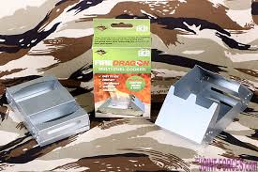
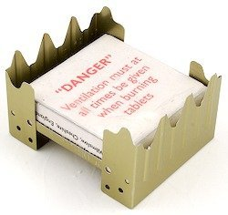
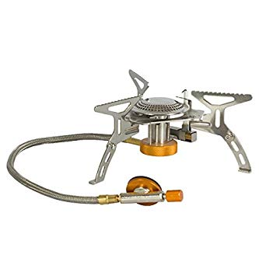
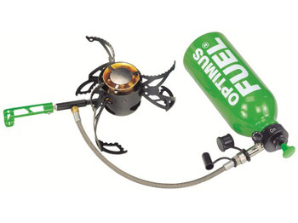
TYPES OF STOVE
Hexamine
Operational Ration Heater/Gel Fuel
Gas
Meths
Petrol
Notes:
Instructor:
Go outside to demonstrate use of stoves.
Heximine tablets are no longer used.
Get cadets to practice lighting different stove types.
Equipment:
Pocket rocket stove x 1
Sqn gas stove x 1
Gas stove with petzl igniter x 1
Jetboil x 1
Petrol stove x 1
Trangia – Mmeths burner x 1
Op Ration Heater x 1
Hexi Stove x 1
Basecamp stove x 1
Gas x 3
Meths x 2
Dragon Fuel/Gel
Petrol container
Hexi blocks
Mess tins x 2
Metal mug x 1
Water bottle (full)

Slide 33
ANY QUESTIONS?
Are there any final questions?
?
Notes:
A chance to ask or answer any final questions.

Slide 34
LEARNING OUTCOMES
LO3: Understand the principles of safe camp craft on an expedition.
Explain food and cooking safety considerations for expeditions.
Notes:
LO3: Understand the principles of safe camp craft on an expedition.
P9: Explain food and cooking safety considerations for expeditions.

Slide 35
COOKING TASK
Logbook
Page 36
Practice cooking some food that could be eaten on an expedition.
When this is complete your instructor should sign page 36 of your First Class Logbook and fill in the Task P9 Activity 1 Initial Expedition Training log sheet.
Notes:
This task covers the mandatory requirement for objectives P9 for LO3.
Cadets must demonstrate how to prepare and cook food to be used on an expedition. This could be turned into a competition, which staff/
Once satisfied that all cadets have an understanding of the topic, instructors must fill in:
Page 36 of the cadet’s first class log book.
Task P9 Activity 1 log sheet. This can be found on Ultilearn.

