Slide 1
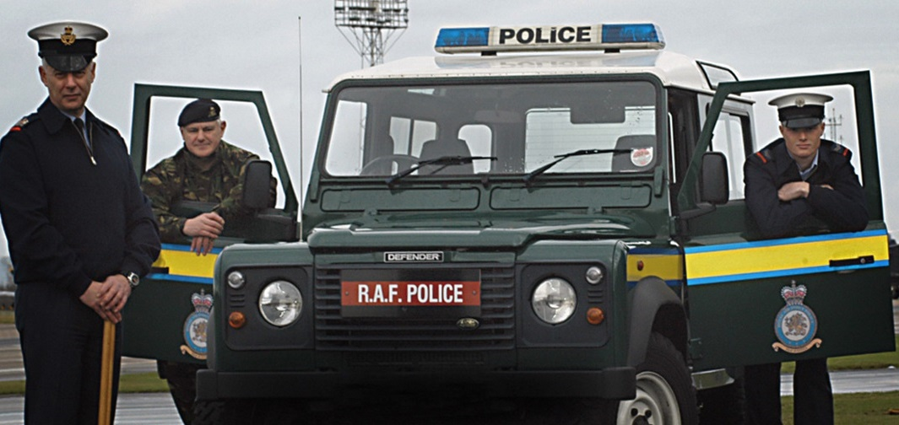
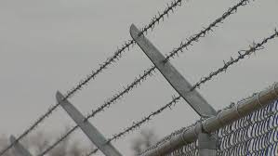
First Class Cadet
LO3
The Royal Air Force - Security
Notes:
Part 3 of 3. This presentation covers the information required to complete the LO3 Royal Air Force topic.
For best results, these instructor notes should be read and discussed with the cadets in conjunction with this presentation and the lesson plan.
Discuss
Why is security important?

Slide 2
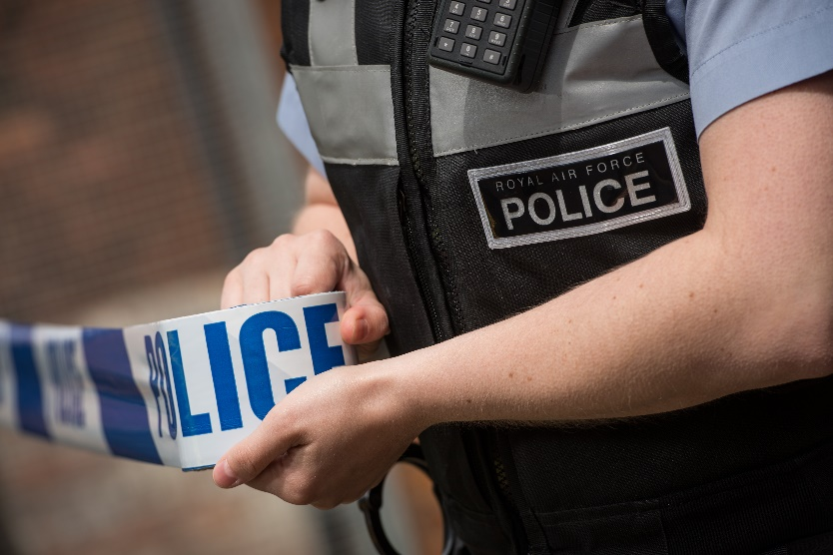
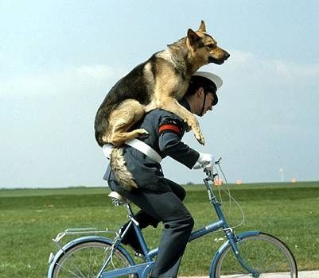
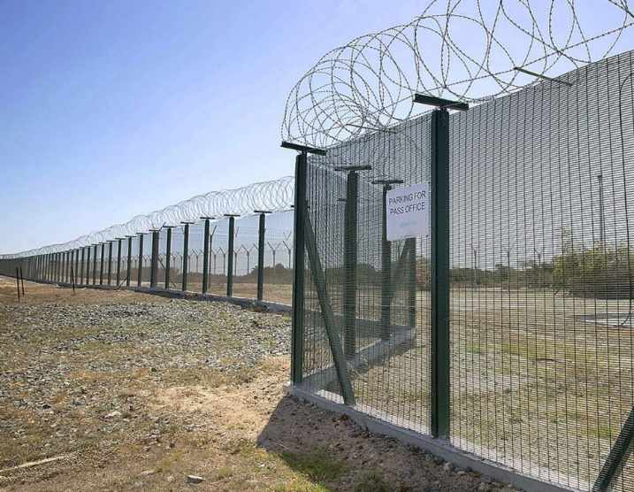
The Royal Air Force
LO3: Understand why security is important.
P3: Identify why security is important.
P4: Identify a minimum of three threats to security and state the actions(s) they would take to minimise these threats.
Notes:
LO3: Understand why security is important.
P3: Identify why security is important.
P4: Identify a minimum of three threats to security and state the actions(s) they would take to minimise these threats.

Slide 3
Security
What does security actually mean?
Defence against:
Direct attack (shooting war)
Indirect attack (spying, sabotage, propaganda)
Terrorists attacks
Notes:
Security is much more than protecting against a direct attack. The Air Cadet Organisation is part of the Royal Air Force, so it is vitally important that everyone takes security seriously.

Slide 4
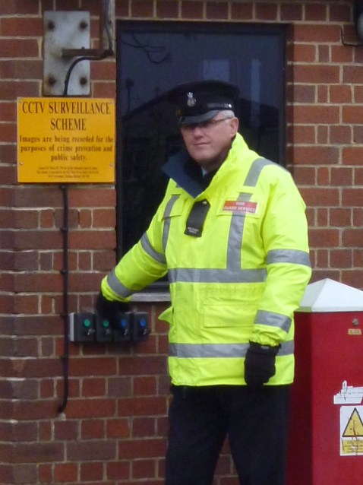
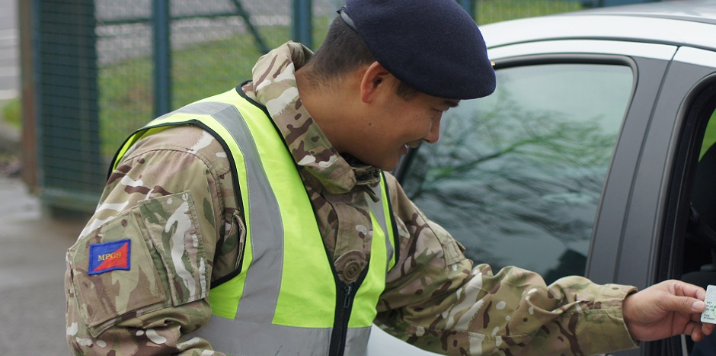
Security on Military Property
Could be an RAF base, army barracks or training area.
Establishments have their own security orders which must be followed.
Notes:
Security is of upmost importance on MOD property to protect everyone from unnecessary harm. The next slide details security precautions that everyone should take, but each site will have their own security instructions which must be followed by everyone, all of the time.

Slide 5
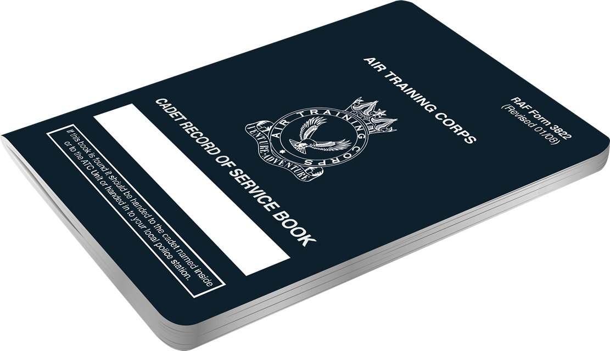
Security on Military Property
Only used authorised entrances and exit points.
ALWAYS carry your ID (RAF form 3822)
Do not run away from a military security officer.
Comply with instructions from security personnel.
Don’t wander around on your own.
If someone is acting suspicious – report them!
Don’t touch unattended bags – report them!
Notes:
Only use authorised points of entry to the unit and always have some means of identity with you. Do not divulge the codes for access systems to anyone who is not in the need to know.
If at any time you are challenged by either a member of the Military Police Guard Service, RAF Police or the Guard Force, do not run away. Comply with any instructions you may be given. Security personnel are there to protect you so please assist them. From time to time, the site may respond to a security alert. You will receive the necessary instruction as to what you should do, please comply with any instruction given.
Do not wander aimlessly around MOD sites. There are almost always hazards and you may be subjecting yourself to unnecessary danger. It may also make you look suspicious to security personnel.
If you see anybody acting suspiciously or you are approached by suspicious persons, report it. Do not put yourself in any kind of danger by approaching the individual, use whatever means possible to alert the RAF Police or security service in charge of the site. If you come across an unattended bag, parcel etc. do not touch it or attempt to move it. Once again, contact security services at the site as soon as possible. Do not leave your baggage unattended. Also make sure that your belongings are marked in some way.

Slide 6
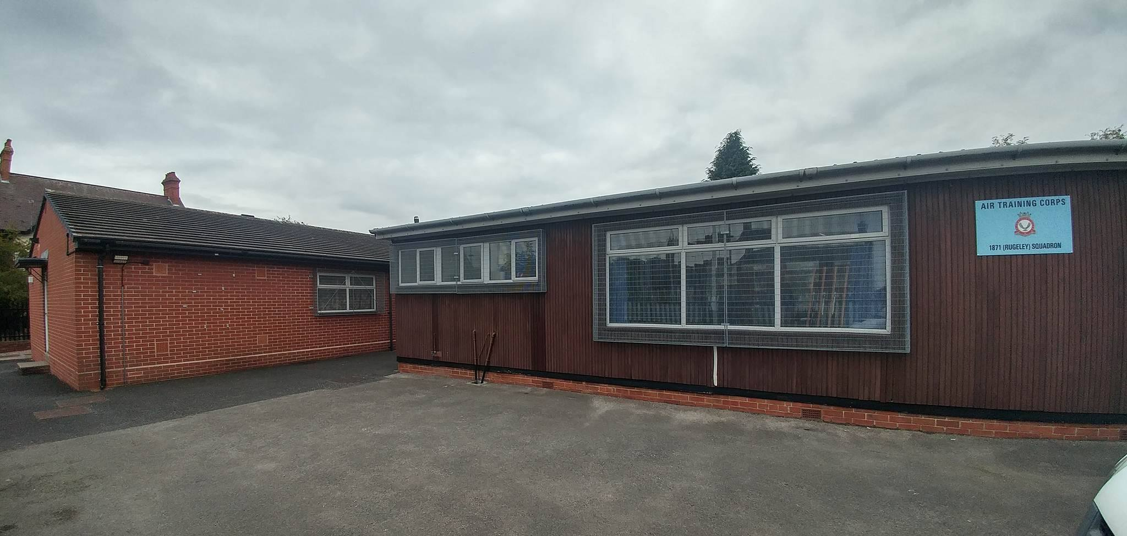
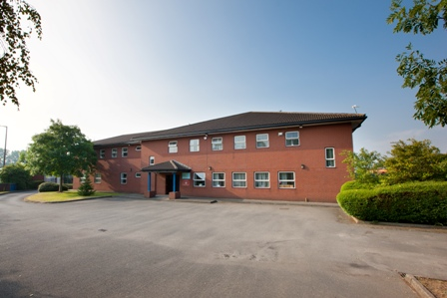
Security at Your Squadron
You should always be aware of the squadron’s security orders and always follow them
Every squadron has their own security arrangements.
Ask a member of staff if you do not know where they are
Notes:
Every squadron has their own security arrangements. These varies because of the wide range of building and size of squadrons across the country. Some squadrons are in standalone portable buildings, others may in Army Reserve Centres and a few are on RAF Bases or Army Barracks.
If in doubt, ask a member of staff.
Every Cadet is responsible for the security for their squadron. If you find anything suspicious on site, e.g., a suspicious package or suspicious behaviour, it’s your responsibility to report it to a member of staff.
There are several countries and organisations which see the UK as an enemy and actively gather information about our countries defence. The threat is small for the ATC; however, it is important that we remain vigilant at all times.

Slide 7
Security is everyone's responsibility!
Notes:
It is the responsibility of everyone, including cadets, to defend the security of the RAF, the MOD and the UK.

Slide 8
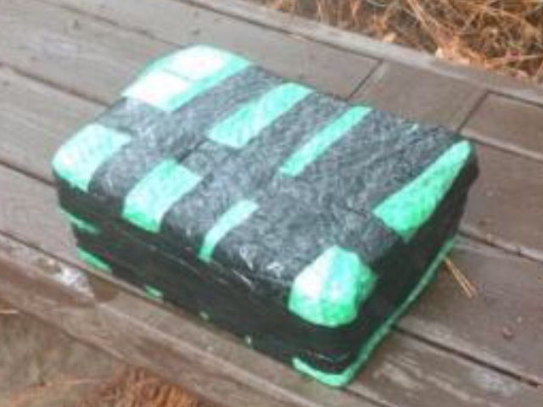
Threats – Packages or Bags.
Unknown packages or bags can be threats.
Do not touch them.
Report to a member of staff if you see a package that looks suspicious.
Notes:
Unknown packages can be threats as they can have something harmful inside. Report any suspicious looking package to a member of staff straight away. Do not touch an unknown package or bag – it may be dangerous!

Slide 9
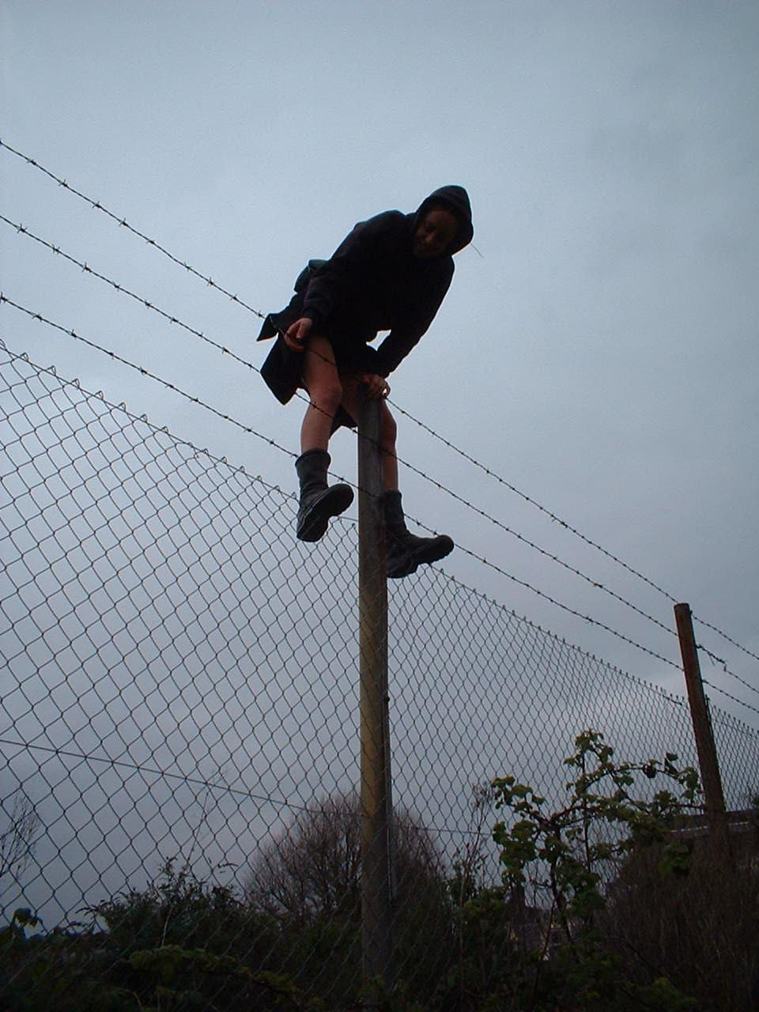
Threats – Unknown Personnel
Unfamiliar people can often be a threat.
Do not approach them.
Report immediately!
Notes:
If you find unfamiliar people without any identification inside the squadron perimeter or lingering around the area of your squadron, they could be a threat. To prevent this you must inform a member of staff immediately. Do not approach them as they may be dangerous.

Slide 10
Threats – Suspicious Letters
Report documents lying around.
Letters can contain threats.
Report them immediately.
Notes:
Any confidential document should be given to a member of staff to prevent them from being passed onto unauthorised personnel or members of the public.
Letters can contain threats. Report them to a member of staff immediately.

Slide 11
What would you do?
If, whilst visiting an RAF station, you see 2 men climb over the perimeter fence and run away from the station. What would you do?
?
Notes:
Threat to Security #1:
Report the incident immediately to an officer or adult.

Slide 12
What would you do?
What would you do if you discovered a fire on your squadron or at a R.A.F. Station?
What would you do if you saw a document marked “Top Secret” laying on a desk?
?
Notes:
Threat to Security # 2 and 3.
Raise the alarm and go immediately to the fire assembly point.
Notify the nearest adult.

Slide 13
Security Orders?
Do you know your squadron’s security orders?
If you are not sure, what do you think they might be?
?
Notes:
On the wall to the left of the main door.
Ask them if they have read them.

Slide 14
Responsibility
Who is responsible for security on a RAF Station?
The RAF Police
The MoD Police
Everyone
The Station Warrant Officer
?
Notes:
Who is responsible for security? Everyone.

Slide 15
Questions
?
Any final questions?
Notes:
A chance to ask or answer any final questions.
Go outside and run through the Op Wideawake process.
Things to search on the minibus and what you are looking for.

Slide 16
BLOCKBUSTERS
Notes:
Open the Blockbusters quiz ppt or use manual version.

