Slide 1
Notes:
Part 2 of 4. This presentation covers the information required to complete PASS criteria of the LO2 Initial Expedition Training topic.
For best results, these instructor notes should be read in conjunction with this presentation and the lesson plan.

Slide 2
LEARNING OUTCOMES
LO2: Be able to use tents and carry equipment safely.
Demonstrate the erection of tents for a walking expedition.
Notes:
LO2: Be able to use tents and carry equipment safely.
P5: Demonstrate the erection of tents for a walking expedition.

Slide 3
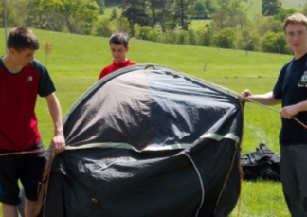
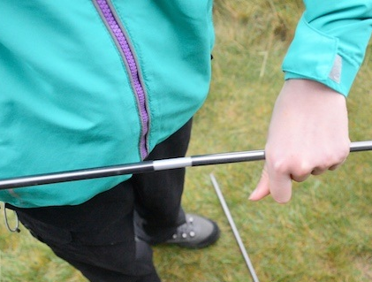
PITCHING A TENT
Resource Book
Page 87
Pitching a tent can be a challenge for those who have not done it before.
Some tents are quite complicated to set up and may need more than one person to put up safely.
It is vital that you practice putting up the tent you are going to use several times before you actually go out and use it on expedition.
Cold or wet weather can make a tent much harder to put up.

Slide 4
PUTTING UP YOUR TENT
Resource Book
Page 87
Some tents are pitched with the outer tent first:
First add the poles to the outer sheet
Peg down the outer sheet with the poles attached.
Crawl inside and clip the inner sheet inside.
Inner sheet can be left inside for quicker pitching next time.
Fig 1: Poles and Outer
Fig 2: Inner sheet (orange) now clipped inside.
Notes:
Outer first tents are pitched with the outer sheet first. The poles are inserted into slots on the outer sheet (these are often colour coded – i.e. Red pole into slot with the red tag). Once this is done the tent will have it’s shape and can be pegged out. Once this is done someone can crawl inside and attach the inner sheet into the outer ‘shell’ of the tent. The inner can be left in when the tent is taken down, this will mean next time the tent is put up the only thing that needs to be done is insert the poles and peg it down.

Slide 5
PUTTING UP YOUR TENT
Resource Book
Page 87
Some tents are pitched with the inner tent first:
First add the poles to the inner.
Peg out the inner tent.
Throw the outer sheet over the top and align the outer door with the inner door.
Peg the outer sheet.
Fig 1: Poles and inner
Fig 2: Outer sheet (green) now pegged over the top.
Notes:
Inner sheet tents are pitched starting with the inner sheet. Poles are attached to the inner sheet, and this gives the shape of the tent. The inner is then pegged out. The outer sheet is then thrown over the top and the doors aligned. The outer sheet can then be pegged out.

Slide 6
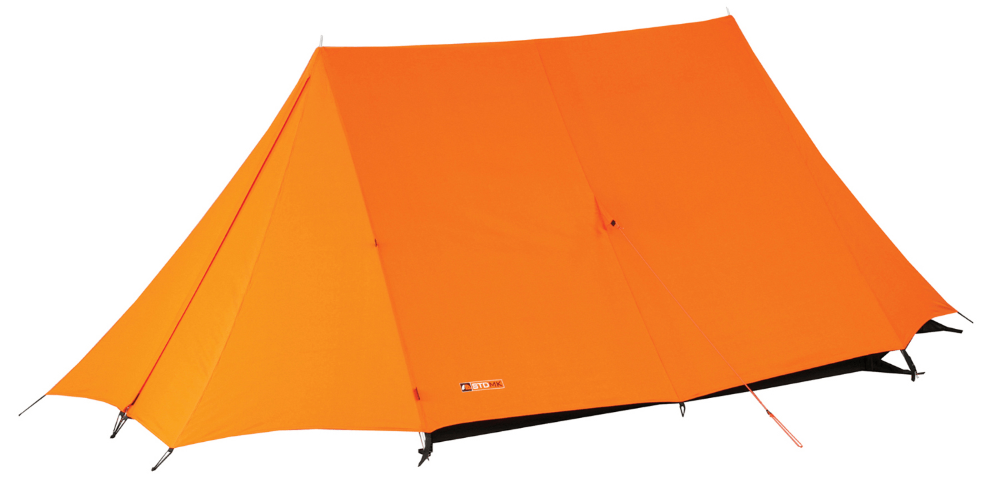
DIFFERENT TYPES OF TENT
Ridge tent
Ridge tents are older style tents, usually used on static camps (i.e. Not an expedition)
Advantages:
Very windproof when pitched with the front facing the wind.
Strong and unlikely to be damaged.
Disadvantages:
Weak if pitched side on to the wind
Heavy
Notes:
Cadets need to understand:
Older tent style, not good for expeditions due to weight
Useful for static camps where the tent won’t be carried in rucksack
If the wind hits the front of the tent it’s strong in the wind, if it hits the side of the tent it’s like the wind hitting a sail!

Slide 7
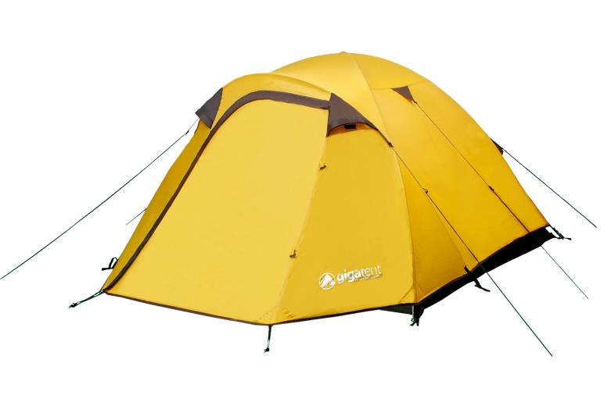
DIFFERENT TYPES OF TENT
Dome tent
Dome tents are fairly common on squadrons and are a good balance of weight and strength.
Advantages:
Same strength against wind in all directions
Light
Easy to put up
Disadvantages:
Deforms in high wind
Water can seep through if the inner and outer sheet touch.
Notes:
Cadets need to understand:
Good style of tent for expeditions; spacious, reasonably light, simple to pitch
However not brilliant in high winds the tents get crushed in by the wind.

Slide 8
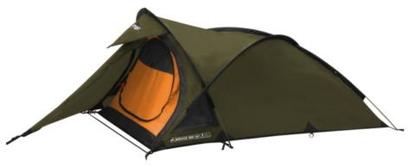
DIFFERENT TYPES OF TENT
Semi Geodesic Tent
Semi Geodesic tents and a great balance of strength, and weight, but come at a higher price.
Advantages:
Strong in wind
Lightweight
Disadvantages:
High price
Can be difficult to put up
Smaller than other tents
Notes:
Cadets need to understand:
Most ideal tent for DofE; strong in the wind, lightweight
If using one of these on expedition cadets must understand how to pitch it before heading out on expedition
High price point can be an issue if buying one.

Slide 9
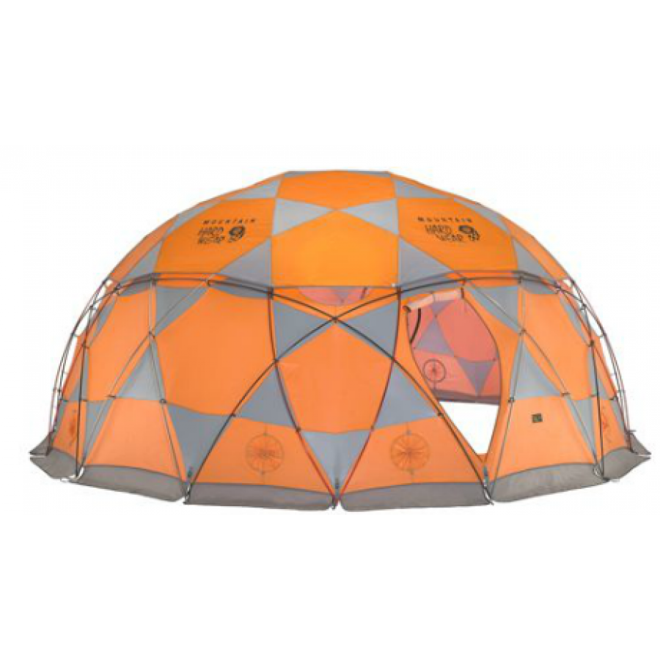
DIFFERENT TYPES OF TENT
Geodesic Tent
Geodesic tents are incredibly strong in wind but also very heavy and very expensive.
Advantages:
Very strong in wind
Disadvantages:
Very high price
Needs a team to put up
Only suitable for base camps
Notes:
Cadets need to understand:
Brilliant tent for static base camps and big expeditions where they won’t be carried
Very expensive tents; the pictured tent is upwards of £2000

Slide 10
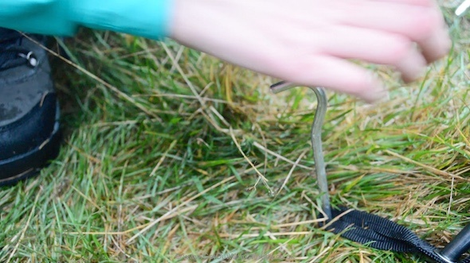
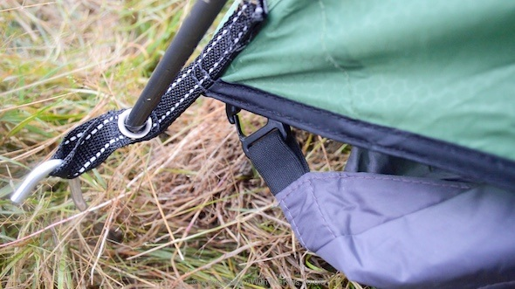
TENT PEGS
The end of a tent peg should be pointed inwards towards the tent.
Don’t place it straight down or away from the tent.
Pegging down a tent properly protects it from high winds.
Notes:
When pegging tents, always ensure that the end of the peg is pointing inwards towards the tent, and not straight down or away from the tent. This will provide maximum strength, particularly in the wind.

Slide 11
A NOTE ON HOW TO PEG TENTS DOWN
Which way is correct?

Slide 12
A NOTE ON HOW TO PEG TENTS DOWN
Notes:
Instructor to explain:
When pegging tents, always ensure that the end of the peg is pointing inwards towards the tent, and not straight down or away from the tent. This will provide maximum strength, particularly in the wind.

Slide 13
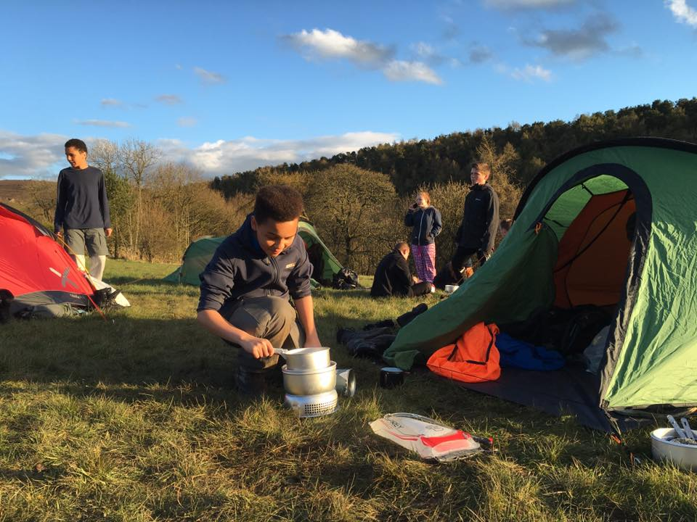
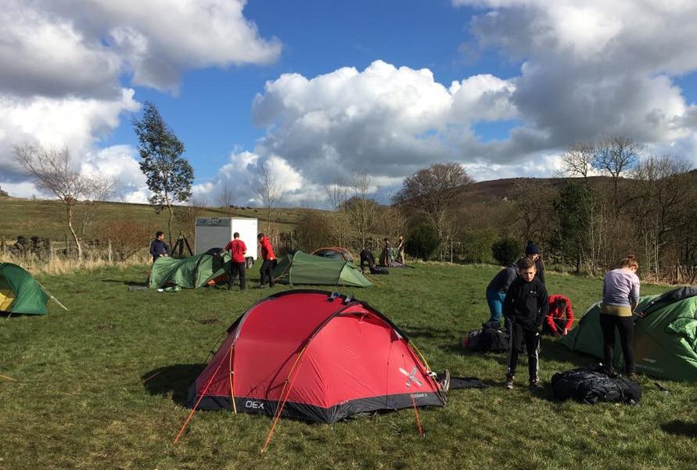
SITING A TENT
Resource Book
Page 87
Choose a good spot to site your tent for a good nights sleep!
Find shelter from prevailing winds and site on flat land which safe from potential flooding.
Don’t pitch tents directly below trees and remove any stones or sticks from underneath a tent.
Keep your tent at least 2 metres away from other tents.
Notes:
Choosing a good spot for a tent will help you to get a good night’s sleep and protect you from potential annoyance or inconvenience.
Try and find shelter from prevailing winds and flat land safe from potential flooding (usually at least 50 metres away from rivers or other water). Don’t pitch tents directly below trees; water will fall off the tree onto the tent.
Don’t place stones on the tents guide ropes, use pegs to secure them.
Remove any stones or sticks from underneath a tent. When you are lying down they are surprisingly noticeable, even under a roll mat!

Slide 14
PITCHING A TENT
Notes:
1 minute.
Video on the Squadron’s new tents.

Slide 15
ANY QUESTIONS?
Are there any final questions?
?
Notes:
A chance to ask or answer any final questions.

Slide 16
LEARNING OUTCOMES
LO2: Be able to use tents and carry equipment safely.
Demonstrate the erection of tents for a walking expedition.
Notes:
LO2: Be able to use tents and carry equipment safely.
P5: Demonstrate the erection of tents for a walking expedition.

Slide 17
TENT TASK
Logbook
Page 33
Put up and take down a tent in pairs.
When this is complete your instructor should sign page 33 of your First Class Logbook and fill in the Task P4 Activity 1 Initial Expedition Training log sheet.
Notes:
This task covers the mandatory requirement for objectives P5 for LO2.
Cadets must erect, strike and re-pack a tent. This could be turned into a competition in small teams, to see who can complete the exercise the quickest.
Once satisfied that all cadets have an understanding of the topic, instructors must fill in:
Page 33 of the cadet’s first class log book.
Task P5 Activity 1 log sheet. This can be found on Ultilearn.

Slide 18
LEARNING OUTCOMES
LO2: Be able to use tents and carry equipment safely.
Demonstrate methods of kit packing for an expedition
Notes:
LO2: Be able to use tents and carry equipment safely.
P6: Demonstrate methods of kit packing for an expedition
Handouts:
Rucksack Packing Exercise

Slide 19
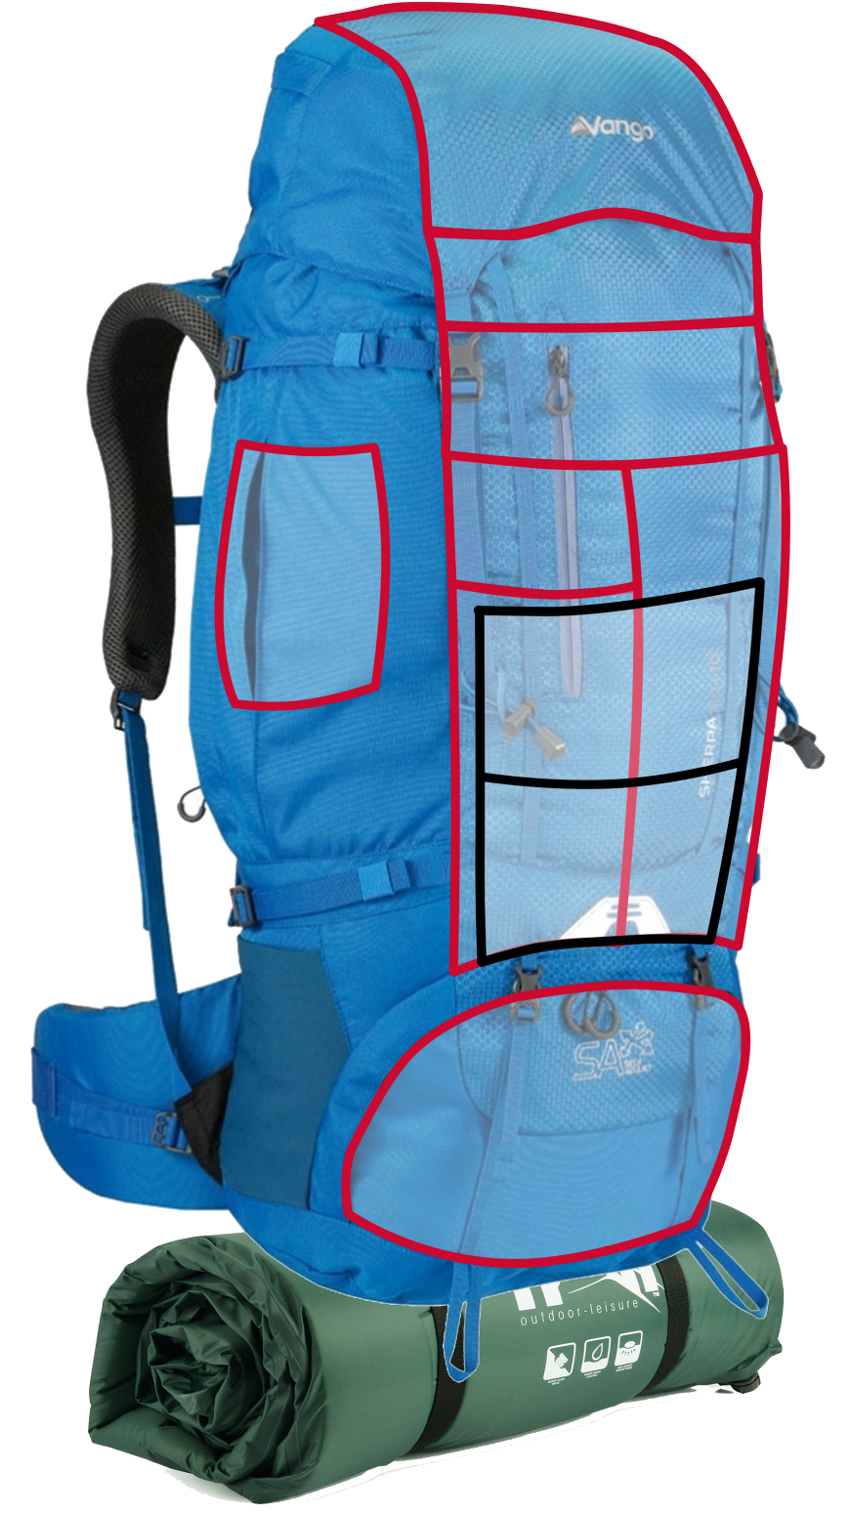
PACKING A RUCKSACK
Snacks
First Aid Kit
Head Torch
Sun-cream
Pocket Tool
Toilet Paper
Resource Book
Page 84
Loading a bag correctly is all about weight distribution and making sure frequently used items are close at hand.
Putting items in the correct place will make your bag much more comfortable to wear.
Waterproofs
Hat and Gloves
Food
Wash Kit
Survival Bag
Water
Tent
Sleeping Bag
Camping Kit
Clothes
Gas
Cooking Equipment
Stove
Camping Mat
Notes:
Equipment you need quickly: place this close to the top or in a lid pocket to avoid having to empty your bag out to get things you will need frequently.
Heavier equipment: best at the bottom, putting it at the top will mean that you are being off-balanced by the weight being higher up.
Water: water bottles in side pockets or use a hydration system such as a Camelbak.
Roll mat: stored outside wherever is best, consider covering it in a bag to avoid it getting soaked.
Liquid fuel: outside and ideally waterproofed.

Slide 20
ANY QUESTIONS?
Are there any final questions?
?
Notes:
A chance to ask or answer any final questions.

Slide 21
LEARNING OUTCOMES
LO2: Be able to use tents and carry equipment safely.
Demonstrate methods of kit packing for an expedition
Notes:
LO2: Be able to use tents and carry equipment safely.
P6: Demonstrate methods of kit packing for an expedition

Slide 22
EXPEDITION EQUIPMENT TASK
Logbook
Page 31
Prepare a presentation about how to prepare expedition equipment.
Present this to the rest of the group.
When this is complete your instructor should sign page 31 of your First Class Logbook and fill in the Task P4 Activity 1 Initial Expedition Training log sheet.
Notes:
This task covers the mandatory requirement for objectives P4 for LO1.
In order to complete the assessment for this task, cadets must give a presentation in which they describe and demonstrate how equipment can be prepared for a two day expedition. The cadet should prepare and bring in a bag of equipment suitable for a two day expedition. They must unpack the bag and explain the reason why each item has been included. If this is not possible then it can be replaced by the Rucksack Packing Exercise.
Once satisfied that all cadets have an understanding of the topic, instructors must fill in:
Page 31 of the cadet’s first class log book.
Task P4 Activity 1 log sheet.
Rucksack Packing Exercise:
Pack the rucksack by drawing and labelling the items from the table below in the rucksack. Make sure they are packed in the right place.

Slide 23
RUCKSACK PACKING TASK
Logbook
Page 33
Demonstrate how to pack a 65-75 litre rucksack for an overnight expedition.
When this is complete your instructor should sign page 33 of your First Class Logbook and fill in the Task P6 Activity 1 Initial Expedition Training log sheet.
Notes:
This task covers the mandatory requirement for objectives P6 for LO2.
In order to complete the assessment for this task, cadets must give a presentation in which they prepare and bring in a 65-75 litre rucksack suitable for an overnight expedition. They must unpack the rucksack and explain the reason why each item was packed as and where it was. Instructors should also check that the cadet understands the importance of carrying a rucksack comfortably and safely (including shoulder straps, waist band and chest strap). If this is not possible then it can be replaced by the Rucksack Packing Exercise.
Once satisfied that all cadets have an understanding of the topic, instructors must fill in:
Page 33 of the cadet’s first class log book.
Task P6 Activity 1 log sheet.
Rucksack Packing Exercise:
Pack the rucksack by drawing and labelling the items from the table below in the rucksack. Make sure they are packed in the right place.

Slide 24
ANY QUESTIONS?
Are there any final questions?
?
Notes:
A chance to ask or answer any final questions.

