Slide 1
Presentation Skills
Describe attributes of a good presenter
Create a logical, well structured and clear presentation
Deliver a 10 minute presentation on a subject of your choice

Slide 2
What is a Presentation?
Activity: Write down on a post it note
‘A speech or a talk where information is delivered to an audience’

Slide 3
What makes a Good Presenter?
In groups: Annotate the diagram with things you look for in a good presenter
Confident
Clear Voice
Calm
Interesting Tone
Open Body Language
Good sense of humour
Well Prepared
Eye Contact
Good Listener

Slide 4
Why be a Good Presenter?
Good Presenter
Personal Confidence
Experience for Jobs/Interviews
Inform and Educate Others
Communication Skills
In groups/pairs: Make a mind map of all the reasons why it is helpful to be a good presenter

Slide 5
Structuring a Presentation
Introduction
Development
Consolidation
Title
Aim/Objectives
Brief overview
Cover main content
Logical sequence
Recap key points
Conclusion
Any questions
Tell them what you are going to tell them
Tell them it
Tell them what you’ve told them

Slide 6
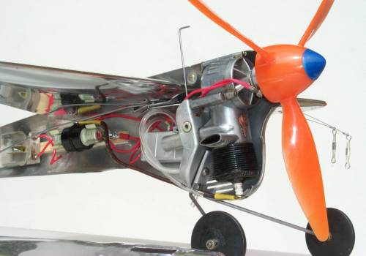
Using Visual Aids
Discuss: What might you use to help you deliver a presentation?
PowerPoint
Videos
Models
Can you think of three other things that you can also use to help you deliver a presentation?

Slide 7
Creating a Presentation
Compare both PowerPoint slides
Create a list of:
5 rules of what to do when you make a PowerPoint
5 things to avoid when making a PowerPoint

Slide 8
Preparing to Deliver a Presentation
Prior planning prevents poor performance
Consider
Room layout
Electronics/equipment
Any visual aids you need
Is your PowerPoint easy to access?
Do you need any notes?

Slide 9
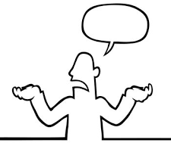
Delivering a Presentation
Clear, well projected voice
Tone that is interesting and varied
Open body language
Activity:
Take turns to read out the story to each other
Now stand up and read it out to the room
What can you do to make your delivery even better?

Slide 10
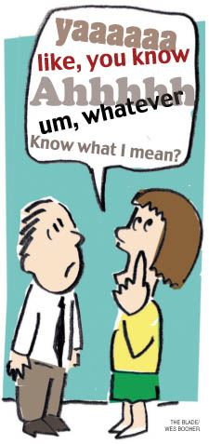
What to Watch Out For…
Filler words: Umm, Errrrrm, Ok, Right then….
Shuffling/rocking feet
Staring at your notes/computer screen
How to avoid it?
Practice, pause, breathe, relax and take it steady!

Slide 11
What if….?
Discuss: What would you do in the following scenarios
Scenario 1
The computer you were using died and you couldn’t get it back on
Scenario 2
Someone was talking through your presentation
Scenario 3
Someone interrupted your presentation by walking through the room
Scenario 4
Someone has a question during the presentation

Slide 12
Preparing for Assessment
Deliver a 10 minute presentation at Squadron
Subject can be about anything
Use visual aids to help your delivery
Plan your presentation using the guide
Practice your delivery before your assessment

Slide 13
Assessment Criteria
Name of cadet:
Date:
Section | Criteria | Score
Preparation | Was the room and equipment set up before the session begun? | 1 2 3 4 5
 | Were the visual aids adequately prepared? | 1 2 3 4 5
Delivery | Was the candidate confident and clear when delivering? | 1 2 3 4 5
 | Was the content relevant and subject knowledge sound? | 1 2 3 4 5
Presentation | Was the structure of the presentation logical and well thought out? | 1 2 3 4 5
 | Was the presentation delivered in the required 10 minutes? | 1 2 3 4 5
(15 to pass, nothing in the 1 column) Total Score:
Comments: (include strengths and areas for development) Signed:

Slide 14
What next?
Get some experience at presenting and instructing
MOI Course at Wing

Slide 15
Any Questions?

Slide 16
Resources for Staff
Human body outline
Poor/good PowerPoint slides
Stories to read out loud
Presentation Structure

Slide 18
A REALLY BAD powerpoint
This is the way we make powerpoints really hard to read and far too busy to understand. This means that as a visual aid they are totally useless. If you are having to deliver a presentation to a lot of people the visual aid is there to help you remember what you are talking about and then to help the audience try and keep track of what you are saying. You might want to include images or videos or sound to help and get your point across, but then again this can always go wrong and so you need to check it to make sure your delivery is smooth and flawless. Try not to read out what it says on the slide, and elaborate the points as best you can. Always include relevant images and a good colour contrast of the text you are using.
Include no more than 5-6 points per slide of a line/two lines maximum. Keep text size really consistent and choose a text that is easy to read. Check the colour contrast is alright on the projector screen and make sure you have practised your delivery. Check your timings and make sure you know what you are saying. Keep animations to a limit otherwise they will get very busy and you will loose the flow of your lesson

Slide 19
A really good PowerPoint
Clear, easy to read points
Text the same size
Not too much text
Helps you make your point
Colour contrast is good
Relevant content/images
Animation is limited, points come up one at a time

Slide 20
This is the story of a very greedy rich man who chanced upon meeting a fairy. The fairy’s hair was caught in a few tree branches. Realising he had an opportunity to make even more money, he asked for a wish in return for helping the fairy. He said, ’All that I touch should turn to gold’, and his wish was granted by the grateful fairy. The greedy man rushed home to tell his wife and daughter about his new boon, all the while touching stones and pebbles and converting them into gold. Once he got home, his daughter rushed to greet him. As soon as he bent down to scoop her up in his arms, she turned into a gold statue. He realized his folly and spent the rest of his days searching for the fairy to take away his wish. | This is a story explaining how adversity is met differently by different people. Asha’s father placed an egg, a potato, and some tea leaves in three separate vessels with boiling water. He asked Asha to keep an eye on the vessels for ten minutes. Once these ten minutes were over , he asked Asha to peel the potato, peel the egg and strain the tea leaves. Asha was left puzzled. Her father explained , ‘Each of these items was but in the same circumstance of being in a pot of boiling water. See how they’ve responded differently. The potato is now soft, the egg is now hard, and the tea has changed the water itself. We are all like these items. When adversity calls we respond in exactly the way they have. Now are you a potato, an egg or are you tea leaves?’
Patty the milkmaid had just finished milking her cow and had two full pails of fresh creamy milk. She put both pails on a stick and set off to the market to sell her pails of milk. Along the way she started to think of all the milk in her pails and all the money she would get for them. ‘Once I get the money, I’ll buy a chicken’, she thought. ‘The chicken will lay eggs and I will get more chickens. They’ll all lay eggs and I can sell them for more money. Then I’ll buy the house on the hill and be the envy of everyone in the village. They’ll ask me to sell the chicken farm, but I’ll toss my head like this and refuse’. So saying, Patty, the milkmaid tossed her head and dropped her pails. The milk spilled onto the ground while Patty cried. | Once upon a time there was a rose who was very proud of her beautiful looks. Her only disappointment was that she grew next to an ugly cactus. Every day, the rose would insult the cactus on his looks while the cactus stayed quiet. All the other plants in the garden tried to make the rose see sense, but she was too swayed by her own good looks. One summer, the well present in the garden grew dry and there was no water for the plants. The rose began to wilt. She saw a sparrow dip her beak into the cactus for some water. Though ashamed, she asked the cactus if she too could have some water. The kind cactus readily agreed and they both got through the tough summer as friends.

Slide 21
Presentation Plan Name:
Title: | Location: Date: | Equipment available:
Introduction: | Development: | Consolidation:
Timings:

Slide 22
Assessment Criteria
Name of cadet:
Date:
Section | Criteria | Score
Preparation | Was the room and equipment set up before the session begun? | 1 2 3 4 5
 | Were the visual aids adequately prepared? | 1 2 3 4 5
Delivery | Was the candidate confident and clear when delivering? | 1 2 3 4 5
 | Was the content relevant and subject knowledge sound? | 1 2 3 4 5
Presentation | Was the structure of the presentation logical and well thought out? | 1 2 3 4 5
 | Was the presentation delivered in the required 10 minutes? | 1 2 3 4 5
(15 to pass, nothing in the 1 column) Total Score:
Comments: (include strengths and areas for development) Signed:

