Slide 1
Unit 2
Ground Handling
ACP 34.3
Aircraft Handling

Slide 2
Recap
Aircraft Maintenance
Ground Handling

Slide 3
Seeing in & Seeing off
Aircraft arrivals and departures are usually attended by a handling team comprising two tradesmen.
  The handling team will marshal an arriving aircraft into a parking area which has been cleared of FOD
  When signalled by the aircraft captain, chocks are inserted and ground power and any necessary ground servicing equipment is connected.
  Fire extinguishers are positioned and manned as required during engine shut-downs
  Aircraft steps are positioned and the aircrew are assisted with unstrapping.
  The handling team will then fit safety devices (eg safety pins to make the ejection and any other covers, blanks and plugs that are needed – eg cover or sleeve over the pitot head, a plug for the static vent).

Slide 4
Marshalling
The extent of the marshalling assistance given will depend upon:
  the pilot’s familiarity with the airfield,
  the number of obstructions,
  the size of the aircraft
  the field of view from the cockpit.
At an unfamiliar airfield taxiing instruction can be passed by radio;
For a long route, marshallers may be stationed at intervals, or “follow me” vehicles may be used.
The pilot is responsible for the safety of the aircraft and is not required to comply with marshalling instructions he considers to be unsafe.

Slide 5
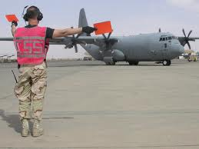
Day Marshalling
Marshalls identify themselves to pilots by energetic waving of the arms in a circular motion & wearing hi-vis clothing.
The Marshalls may indicate where the aircraft must finally be stopped by standing on the required spot with arms outstretched, facing towards the final position of the aircraft.
The pilot is then free to taxi the aircraft in a path of his own choosing to the spot indicated.
If obstructions exist, two extra personnel may be required to walk ahead of the aircrafts wing tips and signal to the pilot if there is sufficient clearance for the aircraft to pass the obstructions.

Slide 6
Night Marshalling
Taxiing at night requires more detailed marshalling directions
If dispersal areas are floodlit, marshalling assistance can be reduced to that given in daylight.
Navigation lights must always be on, and taxi lights used
Care should be taken not to dazzle the marshaller
Marshallers carry wands or torches for identification and must be visible at all times by the pilot.
If the pilot looses sight of the marshaller they must stop and wait for them to catch up.
Taxi Lights
Nav Lights

Slide 7
Danger Zones
Danger zones are those areas in which there is a high risk of injury to personnel when aircraft components or systems are operated on the ground.
Danger zones include:
  engine intakes - sucking
  Engine exhausts – blowing & hot
  propellers – always considered as “live”
  helicopter rotors – prone to “blade sail” where they rotate and bring the blades closer to ground height.

Slide 8
Wheels, brakes & fires
Aircraft wheel brakes are made of two components:
  a pad of heat-resistant and hard-wearing fibre presses
  a disc attached to the wheel (or it may be a drum instead of a disc in some simple aircraft).
The friction between the pad and disc slows the aircraft.
Friction heats up the disc – which can, in prolonged taxiing, abnormal loading or heavy landing can cause a fire.
The Marshalling team are in charge of this until the Fire Service arrives. The safest course of first aid action against an aircraft wheel or brake fire is:
  To stand forward or rearward of the wheels depending on the prevailing wind, i.e. upwind, but never in line with the axle
  To operate the fire extinguisher at the limit of its range, and to spray the extinguishing downwards 0.3m away from the wheels

Slide 9
Manhandling & Towing
Aircraft are never taxied in to or out of hangers – they are towed or manhandled instead
The tow vehicle connects to the aircraft by a fixed towbar to the wheel or nose. If manhandled it is moved by pushing on strong areas - not control surfaces
Handling parties must be qualified and consist of:
  An experienced supervisor.
  One person in the cockpit to operate the brakes when required.
  One at each wing tip to ensure obstacle clearance.
  Either a driver for the towing vehicle, or a sufficient number of persons to manhandle the aircraft.

Slide 10
Parking Process
Park the aircraft facing into wind
Ensure that no part of one aircraft overlaps any part of another.
Double chock the wheels – fore and aft.
Release the brakes.
Check the electrical services, ignition switches and fuel cocks are turned off.
Apply control locks.
Fit pitot and static vents covers.
Lock canopies and doors, fit canopy, wheel and engine covers and set drip trays.

Slide 11
Fuel & Refuelling
The RAF and RN have 4 types of fuel:
  AVGAS – aviation gasoline.
  AVTUR – aviation turbine fuel (kerosene).
  AVTAG – aviation turbine widecut gasoline.
  AVCAT – aviation turbine fuel, used largely by the RN.

Slide 12
Fuel & Refuelling
Aircraft are normally refuelled after every sortie or before it is parked/hangared to stop condensation forming inside the tank. This also reduces the setup time for future sorties.
Aircraft may be refuelled in many ways:
  Jerry can
  Bowsers (fuel tanker)
  High pressure from ground tanks
  Hand or mechanical pump from ground or portable tanks
  Air-Air Refuelling (AAR)
Static electricity can cause sparks leading to a fire; to reduce this the aircraft, pumping equipment & hose are is earthed

Slide 13
Refuelling – Local Orders
Other precautions must be taken are laid out in the local orders:
  Correct grades of fuel and oil are put into the appropriate tanks.
  Leave air space in oil tanks for expansion of oil when heated.
  Never refuel an aircraft in a hangar or with the engine running
  Always filter the fuel
  No cigarette lighters or matches around the aircraft
  Wear rubber or crepe soled shoes.
  Avoid fuel spillages - call a fire tender if one occurs.
  15m exclusion zone for working on electrical or RT equipment
  40m exclusion zone for aircraft with engines running
  Emergency escape routes for refuelling vehicles.
  Place suitable fire extinguishers ready for use.
  Stand only on the approved walkways on the aircraft.
  Replace filter caps and check they are fitted properly.
  Enter details of the refuelling/defuelling in MOD Form 705.

Slide 14
Refuelling – Pressure Refuelling
Pressure refuelling is AAR & Tactical Operations such as Harriers & Support Helicopter Force (SHF).
In pressure refuelling the nozzle makes a fuel tight fit with the aircraft. This allows higher pressure & faster delivery of fuel.
All systems have shut off valves to prevent over filling.
Bonding precautions are still required
Aircraft can be refuelled by this method with their engines running (hot refuelling) – but strict precautions must be followed.

Slide 15
Loading
Large aircraft have an Air Load Master / Air Quartermaster, whose responsibilities include:
  Supervising the loading process
  Securing loads
  Ensuring the centre of gravity (C of G) is within limits.
  Satisfying the Captain of these
Overloading has the following effects:
  Increases take off & landing distances.
  Increases the stalling speed
  Reduces rate of climb.
  Reduces range
  Reduces endurance.
  Reduces the aircraft’s ceiling height
  In twin or multi-engined aircraft it may make it impossible to maintain flight in the event of an engine failure.
Each of these ensures the aircraft is safe to fly

Slide 16
Questions?

Slide 17
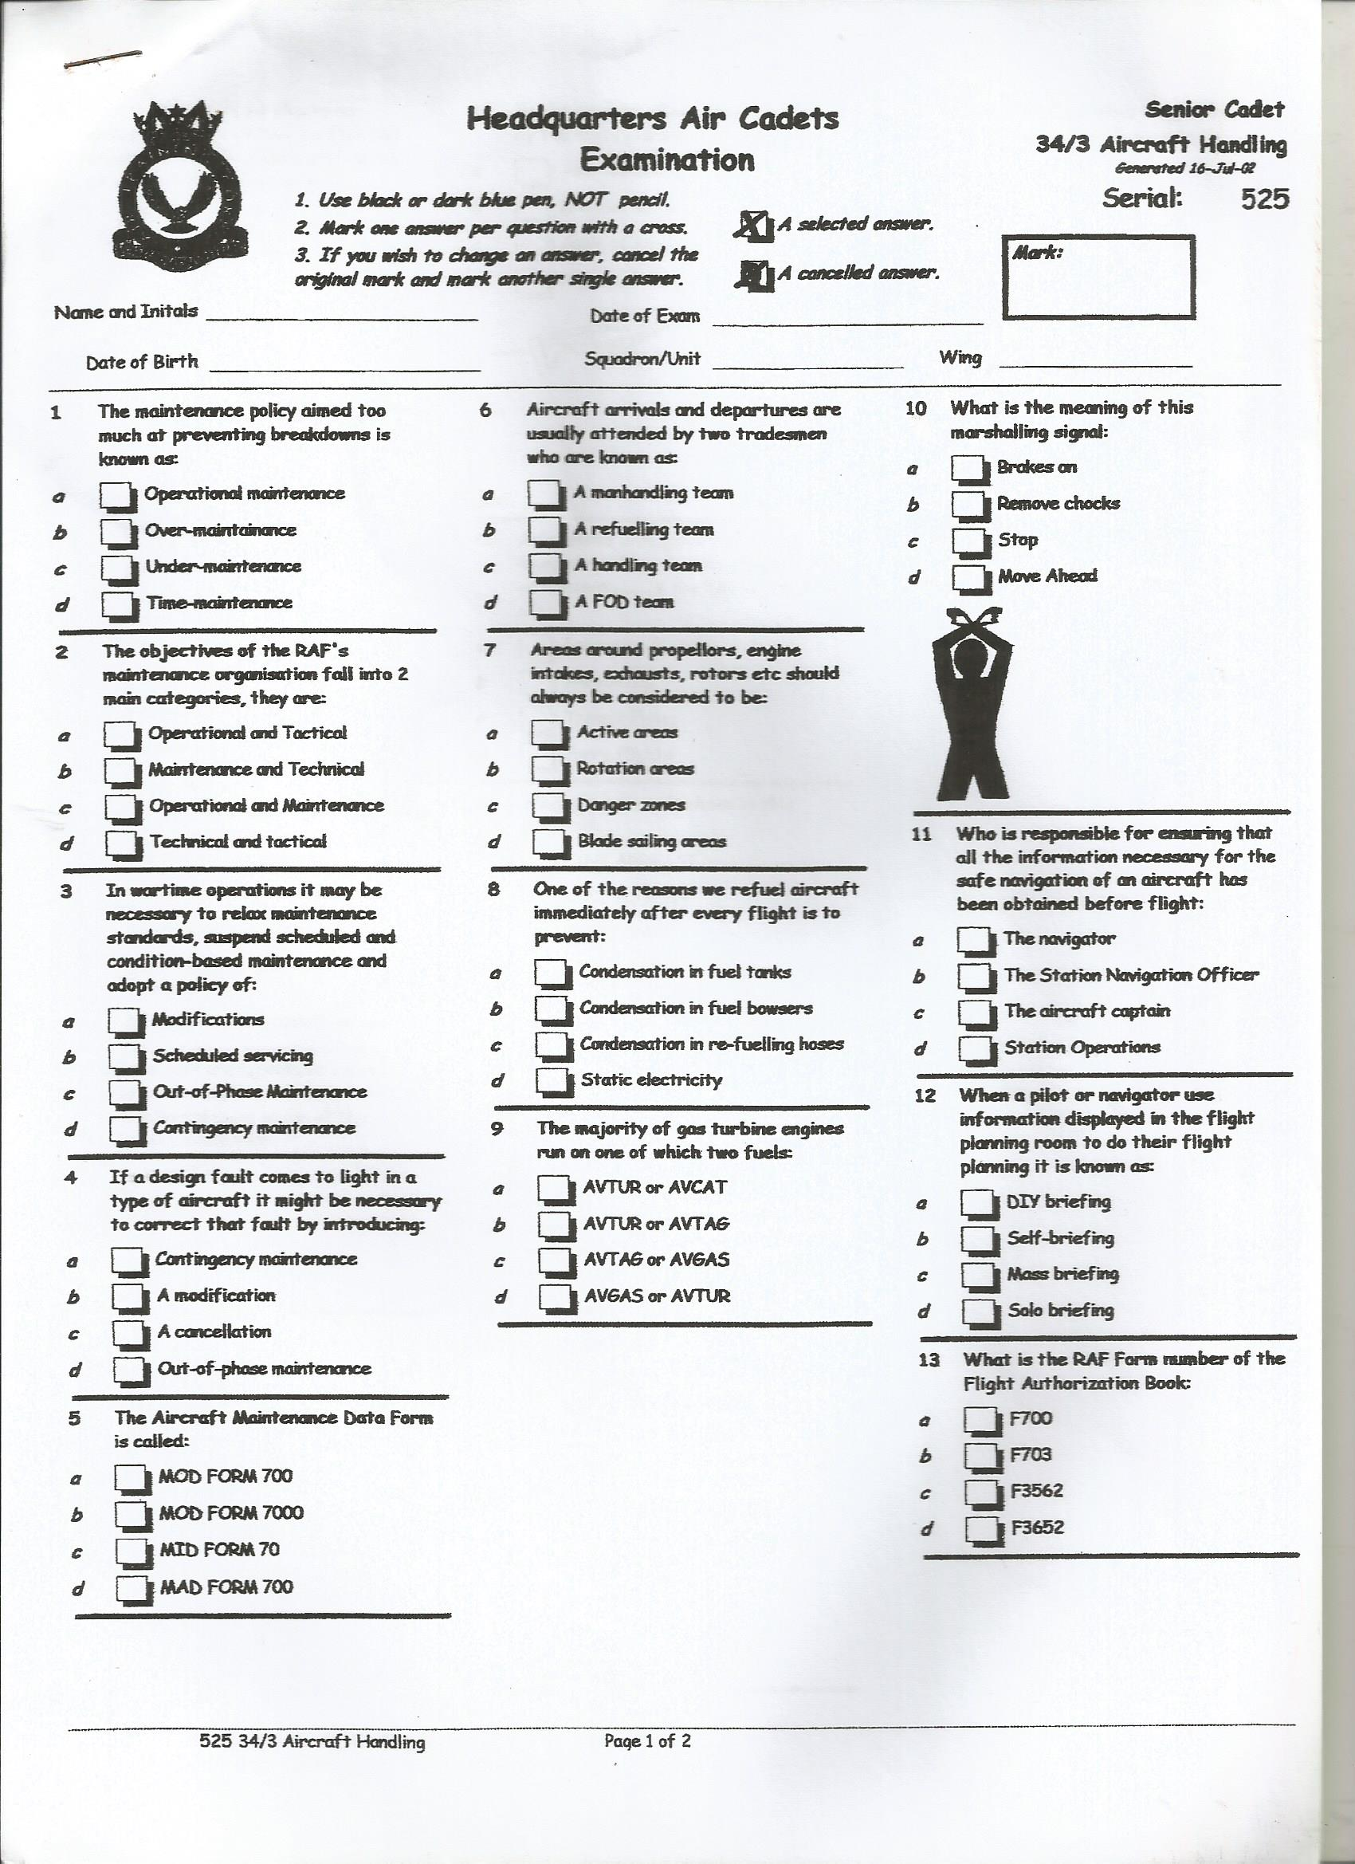
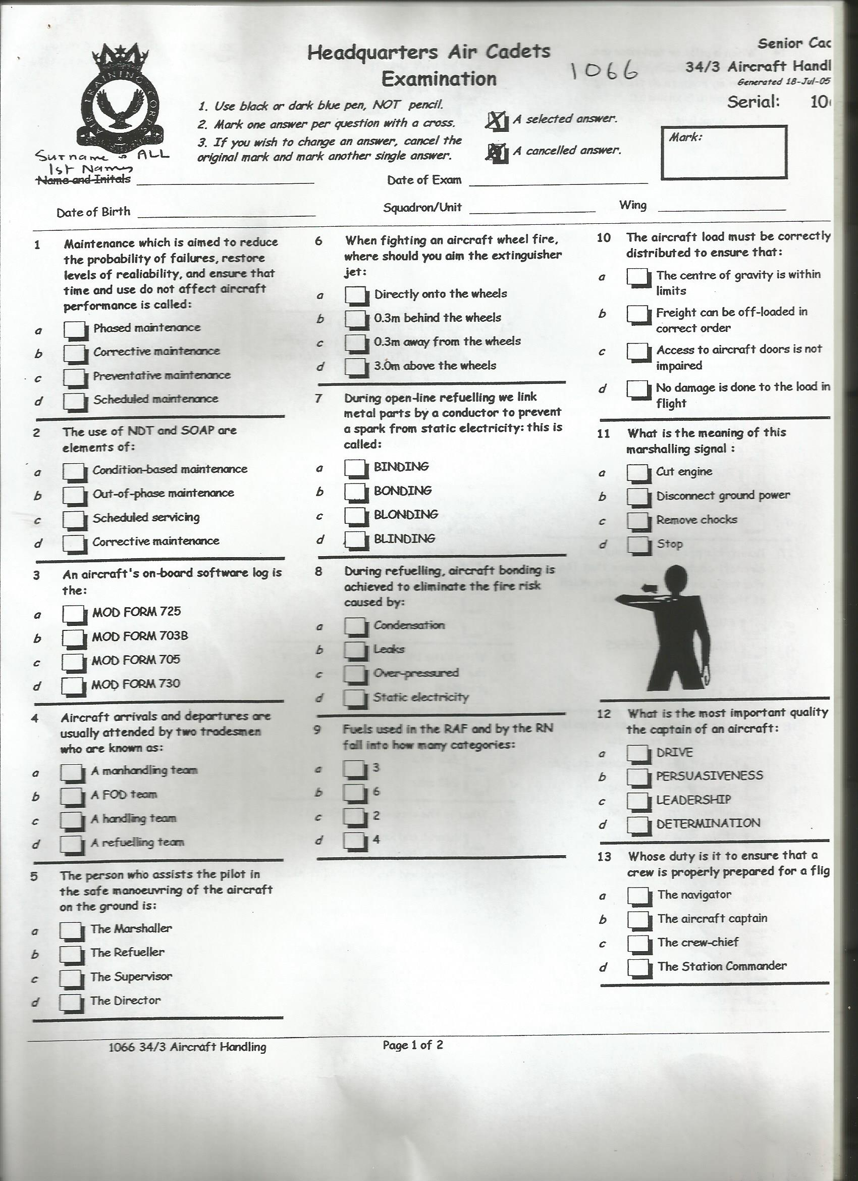
Practice questions
Answers
5 a
6 c
7 a
9 b

Slide 18
Practice Questions
Answers
6 c
7 b
8 d
9 d

