Slide 1
Notes:
Part 2 of 3. This presentation covers the information required to complete PASS criteria of the LO2 Map Reading topic.
For best results, these instructor notes should be read in conjunction with this presentation and the lesson plan.
Handouts:
6 Fig GR Ex 1
National Grid aide memoire
Task P3 Activity 2 Potters Bar
Aides:
Hexham and Haltwhistle 1:50k map
Halstead area laminated 1:25k maps
Globe
Exercise Ball
OS Picture of UK
Compass with romer
Romer

Slide 2
LEARNING OUTCOMES
LO2: Know the scales and features of Ordnance Survey maps.
Use grid referencing systems on Ordnance Survey maps to find locations.
Notes:
LO2: Know scales and features of Ordnance Survey maps.
P3: Use grid referencing systems on Ordnance Survey maps to find locations.

Slide 3
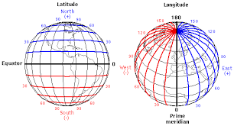
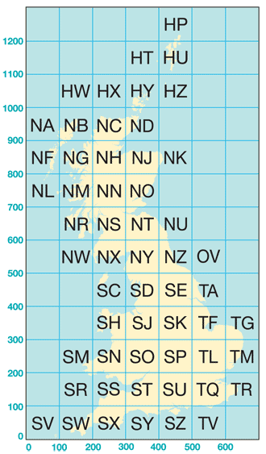
POSTION LOCATING
There are different methods of locating your position:
Latitude & Longitude
GPS
What3Words
Google Maps
OS Grid References
4-figure Grid Reference
6-figure Grid Reference
Notes:
There are two primary methods of locating your precise position:
Latitude and Longitude – used by anything relying on GPS and other countries
Ordnance Survey Grid References – used in UK
Think back to radios: GRID

Slide 4
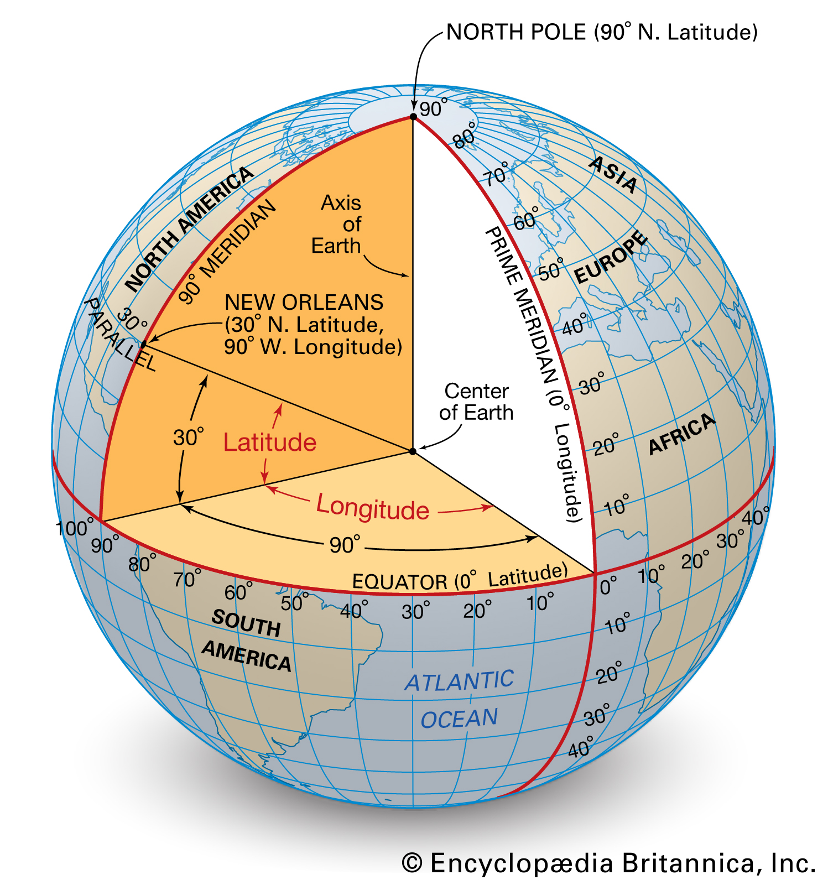
LATITUDE AND LONGITUDE
Latitude = 90º from Equator to the poles
Longitude = 180º east or west of the Prime Meridian
Used by all other countries and GPS
GPS is expressed in a numeric format:
51.942525, 0.650517 =
51º 56’ 33.1”N, 0º 39’ 01.9”E
Notes:
Show on Globe
Latitude is a measurement north or south of the Equator. It is given in degrees, minutes and seconds.
There are 90 degrees from the Equator to the North Pole
Each degree is split into 60 minutes
Each minute is split into seconds
Longitude is a measurement east or west of the prime meridian at Greenwich. It is given in degrees, minutes and seconds.
There are 180 degrees east or west of the prime meridian
Each degree is split into 60 minutes
Each minute is split into seconds
Front door of the Squadron is 51 degrees, 56 minutes, 33.1 seconds / 0 degrees, 39 minutes, 01.9 seconds East.
Expressed as a numeric value for GPS this is 51.942525 North, 0.650517 East.

Slide 5
LATITUDE AND LONGITUDE
Notes:
This video is 4 mins, 10 seconds long.

Slide 6
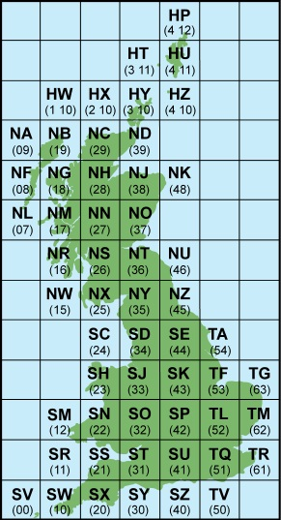
THE NATIONAL GRID
Resource Book
Page 72
The UK is covered in a grid of 100km x 100km grid squares.
Each square is represented by two letters.
All references start at the South-west corner of SV (false origin).
Disadvantages?
Notes:
The Ordnance Survey National Grid reference system is a system of geographic grid references used in Great Britain, different from using Latitude and Longitude. It is often called British National Grid.
Each OS map has it’s own 2-letter designation. There is no I to prevent confusion with “one” (see SH > SJ).
All references start at the South-west corner. This is known as the false origin as the true origin is V. Look at your map – you will see there are two 6 figure numbers. The first number indicates which 100km square you are in.
Disadvantages
Think back to the definition of a map – a two-dimensional representation of a three-dimensional object.
The earth is not flat.

Slide 7
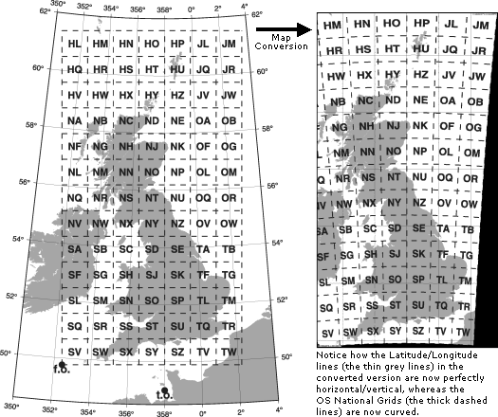
FALSE KILOMETRES
The earth narrows the further North you are
1km on a map in SV is different to 1km on the ground in HU
Notes:
[Put picture of the UK on an exercise ball]
[Use globe]
In order to maintain perfect squares, the ground at the North needs to be stretched out, therefore the actual distance is different – difference is minimal though
The red line at the top is the same width as the line at the bottom.
Latitude and Longitude gives you your exact location. OS Grid References are nearby – 4-figure is within 1km square, 6-figure is within 100m square.

Slide 8
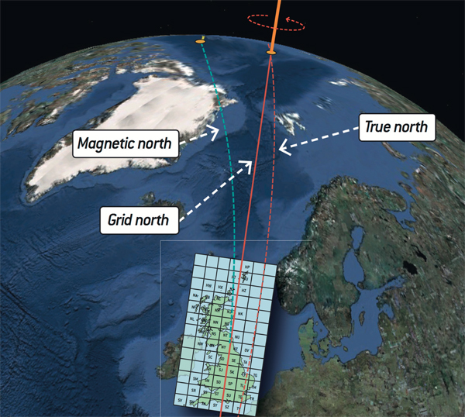
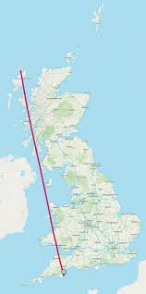
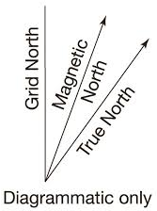
WHICH NORTH?
True North
Grid North
Magnetic North
Notes:
True North – the northerly point on which the Earth rotates.
Grid North – where the centreline of the Northings points to. This is known as the central meridian and is 2 degrees West of the Prime Meridian.
Magnetic North – where the red end of the needle on a compass points to.
Magnetic North moves. It is currently moving East. Grid North and Magnetic North are the same on a line through Cardiff. It will be zero in London in May 2028. You will learn about this in Leading.

Slide 9
ORDNANCE SURVEY
Military purpose to map Scotland after the Jacobite rising of 1745
Need to map the whole country during Napoleonic Wars
Original maps made by triangulation
Now by GPS – master geodetic reference points
Notes:
The origins of the Ordnance Survey lie in the aftermath of the Jacobite rising of 1745 which was finally defeated by forces loyal to the government at the Battle of Culloden in 1746. Prince William, Duke of Cumberland realised that the British Army did not have a good map of the Scottish Highlands to locate Jacobite dissenters. In 1747, Lieutenant-Colonel David Watson proposed the compilation of a map of the Highlands to help to subjugate the clans. In response, King George II charged Watson with making a military survey of the Highlands under the command of the Duke of Cumberland.
There was also a more general and nationwide need in light of the potential threat of invasion during the Napoleonic Wars.
The Ordnance Survey's original maps were made by triangulation. For the second survey, in 1934, this process was used again and resulted in the building of many triangulation pillars (trig points): short (c. 4 feet/1.2 m high), usually square, concrete or stone pillars at prominent locations such as hill tops. Their precise locations were determined by triangulation, and the details in between were then filled in with less precise methods.
Ordnance Survey still maintains a set of master geodetic reference points to tie the Ordnance Survey geographic datum points to modern measurement systems such as GPS. Ordnance Survey maps of Great Britain use the Ordnance Survey National Grid rather than latitude and longitude to indicate position.

Slide 10
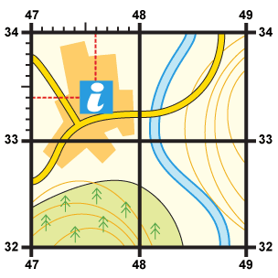
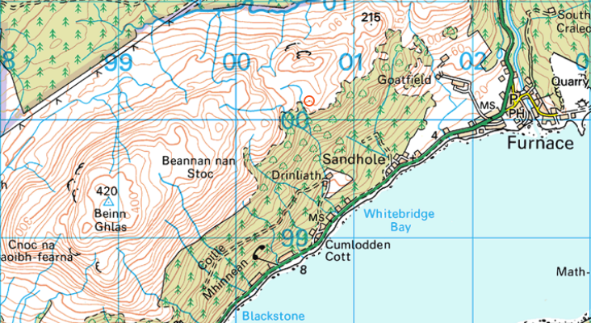
GRID SQUARES
Resource Book
Page 72
Every Ordnance Survey map is covered in a series of grids.
By learning to use these grids we are able to locate a particular point on a map.
Notes:
Every OS map is covered in blue lines which form grids over the map.

Slide 11
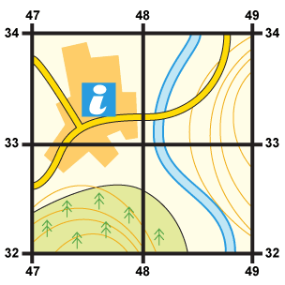
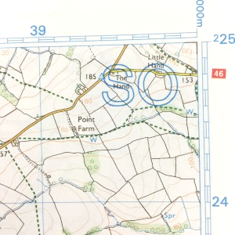
GRID SQUARES
Resource Book
Page 72
Grid lines on an OS map are spaced 1km apart no matter what the scale. This makes it easy to judge the rough distance between counting squares.
Horizontal lines are called Eastings.
Vertical lines are called Northings.
Each line has a number, based on the 100km square it belongs in.
Northings
Eastings
Notes:
All OS maps have 1km grid squares which help measure distance easily. Each grid square has its own number, which comprises of two 2 digit numbers.
Each map contains vertical and horizontal lines. The horizontal lines are called Eastings and the vertical lines are called Northings.
The number printed against each vertical line indicates the number of kilometres that line is east of the starting point for the 100km square to which your map belongs. The number printed against the horizontal grid line indicates the number of kilometres the line is north of the same starting point.

Slide 12
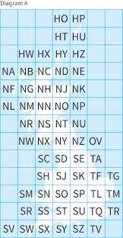
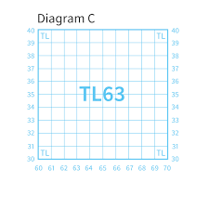
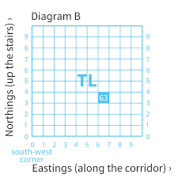
GRID SQUARES
Decreasing scale of squares
Notes:
Main grid is based on 500km squares: A-Z, no I. UK is covered by H, N, S, T. Channel Islands is X.
Diagram A = 100km squares
Diagram B = 10km squares
Diagram C – 1km squares
South-west corner of all maps show full 12 figure grid reference: TL = 5 00 000m Eastings / 2 00 000m Northings
5th 100km square from false origin eastings / 2nd 100km square from false origin northings.

Slide 13
4-FIGURE GRID REFERENCES
Resource Book
Page 72
Notes:
ORDINANCE SURVEY: HOW TO TAKE A 4-FIGURE GRID REFERENCE
The video is 1 minute and 52 seconds long.
A video explaining how to take a 4 figure grid reference.

Slide 14
4-FIGURE GRID REFERENCES
Resource Book
Page 72
Each 1km square has it’s own 4 figure ‘grid reference’.
You can use the numbers from the eastings and northings to find it.
Find the eastings first : ‘along the corridor’.
Then the northings: ‘up the stairs’ .
Northings
Eastings
Notes:
It is fairly easy to locate an object within a 1km square as long as you know what square it is in. This can be done using Easting and Northing to indicate the south west (SW) corner of the square you wish to identify. By using the SW corner of the square, the grid reference is standardised so everyone knows what it means.

Slide 15
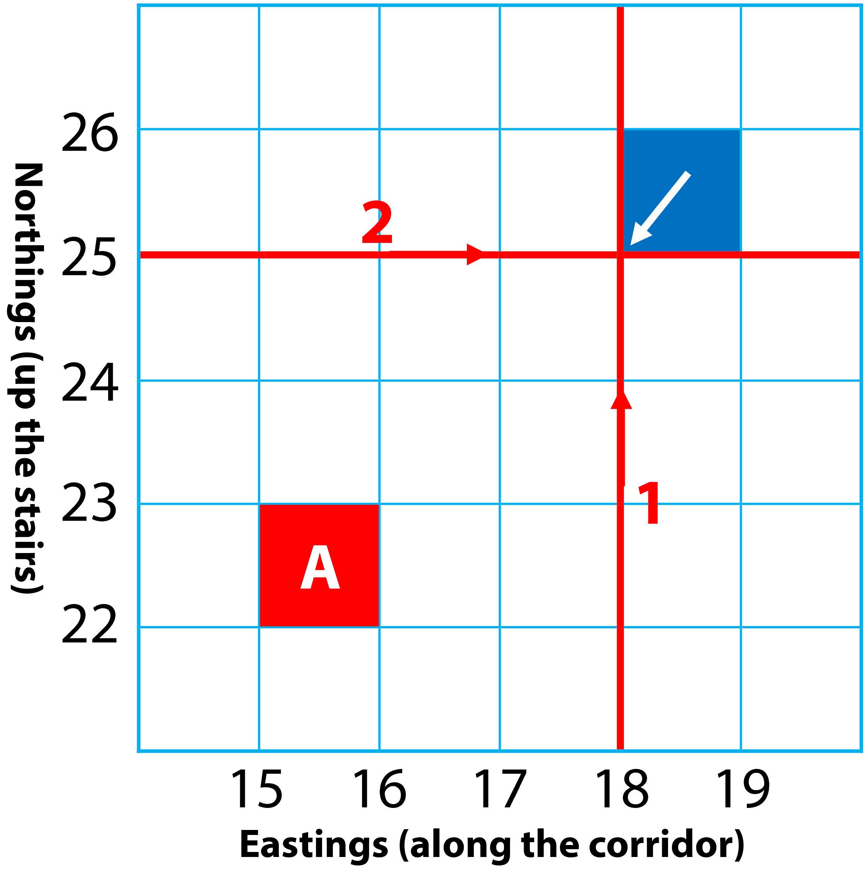
4-FIGURE GRID REFERENCES
Resource Book
Page 72
When giving a grid reference, you always find what the easting is first, then the northing.
So, the grid reference of the blue shaded square marked by the arrow would be:
Easting | Northing
18 | 25
Grid Reference
1825
Notes:
First find the number of the easting line (go along the corridor). Then find the number of the northing line (go up the stairs). This will give you the grid reference of the square.

Slide 16
4-FIGURE GRID REFERENCES
Resource Book
Page 72
What is the grid reference of square ‘A’?
Easting | Northing
15 | 22
Grid Reference
1522
Notes:
First find the number of the easting line (go along the corridor). Then find the number of the northing line (go up the stairs). This will give you the grid reference of the square.

Slide 17
4-FIGURE GRID REFERENCES
Give a 4-figure grid reference of the following:
Railway Station in Haltwhistle
Bus Station in Hexham
Viewpoint on Hadrian’s Wall, approx. 5km NE of Haltwhistle
Windmill at Cholllerton, approx. 8km N of Hexham
Spot Height of 598 on Scarberry Hill, approx. 4km SW of Alston
What is in GRID
NY 77 66
NY 82 61
NZ 03 65
NY 86 51
NY 74 66
Notes:
Using the Hexham and Haltwhistle Landranger Map 87 1:50k map.
Practice symbols and 4-figure grid references.
Give a 4-figure grid reference of the following:
NY 70 63
NY 93 63
NY 75 67
NY 93 72
NY 67 43
What is in GRID:
NY 77 66 – Car Park, Vindolanda Roman site
NY 82 61 – Gardens, Telephone box
NZ 03 65 – Place of worship with tower, Mast
NY 86 51 – Triangulation pillar
NY 74 66 – Campsite, Public House

Slide 18
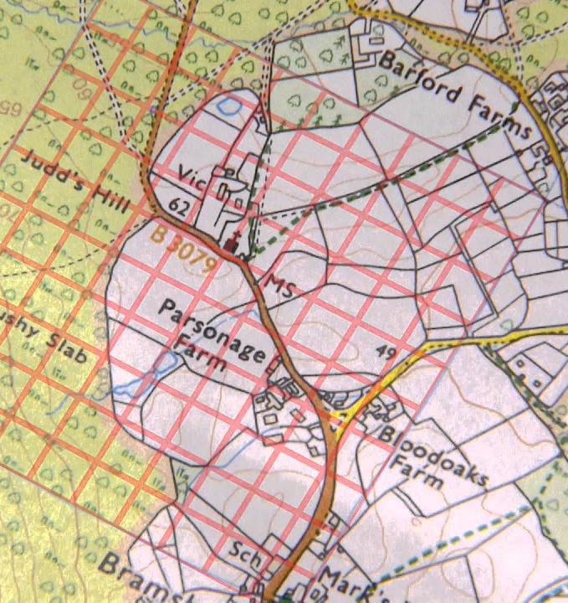
6-FIGURE GRID REFERENCES
Resource Book
Page 73
1km squares are quite large areas!
To find a 100m square area, you can use a 6 figure grid reference by dividing your maps grid square into smaller squares.
Notes:
This 4-figure reference system is a good method of pinpointing objects on the ground like a church or a farm but if there are more than one of the same object in that particular square it may get confusing. To overcome this problem you need to increase your accuracy. There is a system of 6-figure referencing you can use.

Slide 19
6-FIGURE GRID REFERENCES
Resource Book
Page 73
Notes:
ORDINANCE SURVEY: HOW TO TAKE A 6-FIGURE GRID REFERENCE
The video is 2 minutes and 6 seconds long.
A video explaining how to take a 6 figure grid reference.

Slide 20
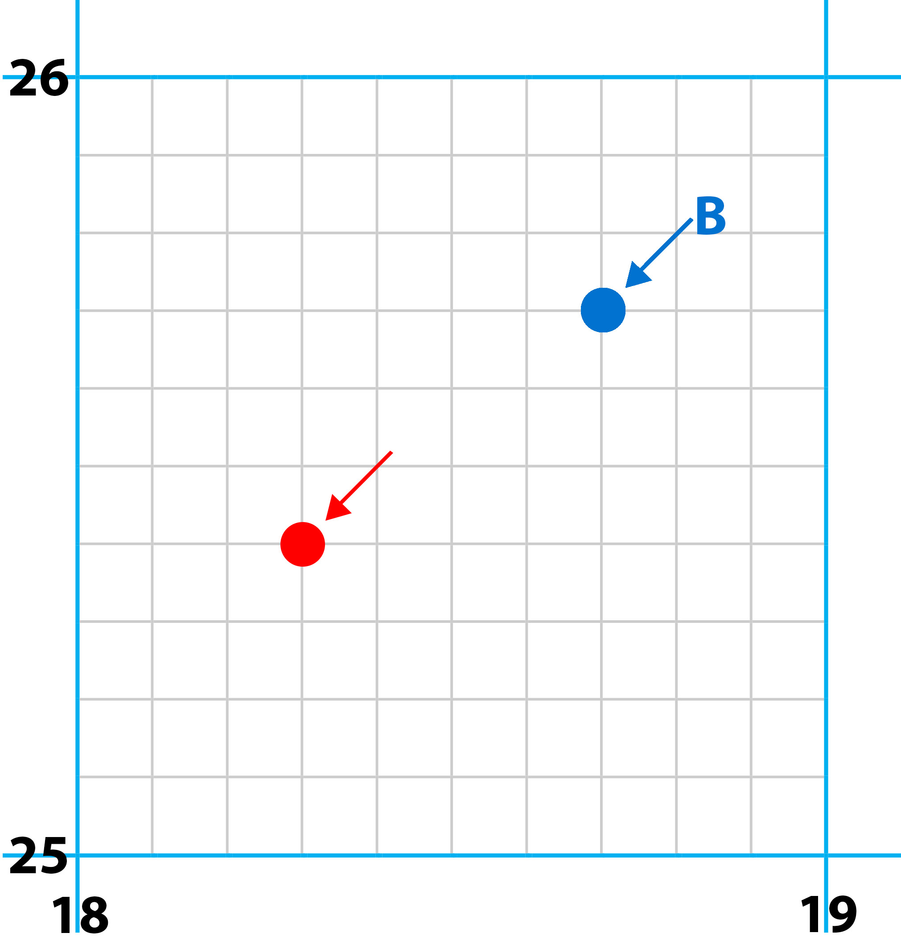
6-FIGURE GRID REFERENCES
Resource Book
Page 73
First find the 4 figure grid reference
Leave a space after each number.
Like this:
Grid Reference
18__ 25__
Notes:
This 4-figure reference system is a good method of pinpointing objects on the ground like a church or a farm but if there are more than one of the same object in that particular square it may get confusing. To overcome this problem you need to increase your accuracy. There is a system of 6-figure referencing you can use.
First identify the four figure grid reference but leave a space after each grid square.

Slide 21
6-FIGURE GRID REFERENCES
Resource Book
Page 73
Mentally divide the northings and eastings into ten parts.
The red dot is 3/10 across the easting.
4/10 up the northing.
Put the missing numbers in the gaps:
Grid Reference
183254
Notes:
1. Mentally divide the northings and eastings into ten parts.
2. Estimate how many tenths the object is into the square. E.g. the object shown in the diagram above would be 3/10 of the easting and 4/10 of the northing.
3. Take the four figure grid reference of the square containing the feature, leaving a gap after each of the numbers, like this: 18 25
4. Insert the number of tenths the object is into the square after the relevant figure in the 4 – figure reference. Remember to insert the tenths of the easting after the first number.

Slide 22
6-FIGURE GRID REFERENCES
Resource Book
Page 73
What is the grid reference of dot ‘B’?
Grid Reference
187257
Notes:
1. Mentally divide the northings and eastings into ten parts.
2. Estimate how many tenths the object is into the square. E.g. the object shown in the diagram above would be 3/10 of the easting and 4/10 of the northing.
3. Take the four figure grid reference of the square containing the feature, leaving a gap after each of the numbers, like this: 18 25
4. Insert the number of tenths the object is into the square after the relevant figure in the 4 – figure reference. Remember to insert the tenths of the easting after the first number.

Slide 23
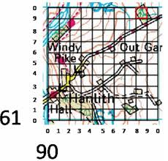
6-FIGURE GRID REFERENCES
Ensure you use the grid square the object is in – not the nearest line.
907 611
Notes:
Do not use the nearest grid line – use the grid square it is in, starting from the South-west corner.
The building in 907 611, not 907 612.

Slide 24
6-FIGURE GRID REFERENCES – Ex 1
Give the 6-figure grid reference for the centre of each of the four symbols
Give the 6-figure grid references for centre of the seven places
Notes:
Using 6 Fig GR Ex 1
Practice symbols and 6-figure grid references.
Picnic area: 165 343
Parking: 161 345
Place of worship with tower: 161 341
Caravan site: 167 341
A: 135 345
B: 143 310
C: 176 322
D: 172 316
Youth hostel: 163 317
Castle: 157 304
Church: 163 304 or 132 330

Slide 25
6-FIGURE GRID REFERENCES – Ex 2
Give a 6-figure grid reference of the following:
Mast across the field from the squadron
St Andrew’s church, Halstead
Western end of ex-RAF Gosfield runway
St Catherine’s church, Gosfield
Halstead Leisure Centre
What is at GRID
TL 772 316
TL 808 304
TL 776 294
TL 780 328
TL 810 333
Notes:
Using the Halstead area laminated 1:25k maps.
Practice symbols and 6-figure grid references.
TL 821 305
TL 815 306
TL 769 309
TL 777 293
TL 820 308
Solar panel farm
Place of worship with a spire, minaret, or dome
Camp site / caravan site
Footbridge
Footpath junction

Slide 26
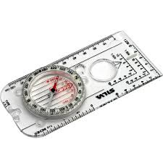
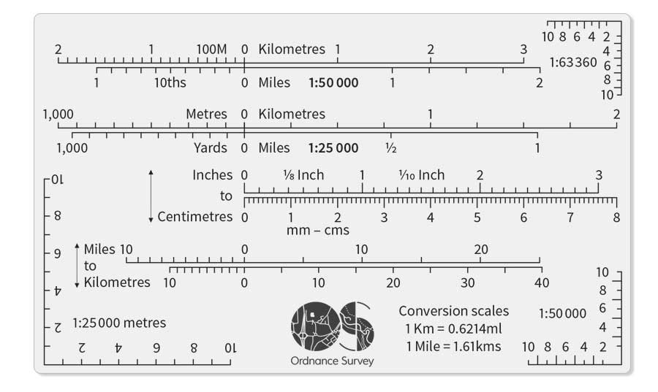
ROMERS
Compasses have a tool called a romer to accurately identify the 100m square box.
Can also buy individual romers.
Notes:
Show romer on compass.
Show standalone romer.
Practice using compass romer.

Slide 27
ANY QUESTIONS?
Are there any final questions?
?
Notes:
A chance to ask or answer any final questions.

Slide 28
LEARNING OUTCOMES
LO2: Know the scales and features of Ordnance Survey maps.
Use grid referencing systems on Ordnance Survey maps to find locations.
Notes:
LO2: Know scales and features of Ordnance Survey maps.
P3: Use grid referencing systems on Ordnance Survey maps to find locations.

Slide 29
GRID REFERENCE TASK 1
Logbook
Page 23
Using an OS map, find 3 features.
Give their 6 figure grid reference.
When this is complete your instructor should sign page 23 of your First Class Logbook and fill in the Task P3 Activity 1 Map Reading log sheet.
Notes:
This task covers the mandatory requirement for objectives P3 for LO2.
Cadets must use an OS map to find some of the land features discussed.
Once satisfied that all cadets have an understanding of the topic, instructors must fill in:
Page 23 of the cadet’s first class log book.
Task P3 Activity 1 log sheet. This can be found on Ultilearn.

Slide 30
GRID REFERENCE TASK 2
Logbook
Page 23
Look at the Potters Bar map and give the 6 figure grid references of the places marked by the 14 arrows.
When this is complete your instructor should check and sign page 23 of your First Class Logbook.
Notes:
Task P3 Activity 2 Potters Bar
This task covers the mandatory requirement for objectives P3 for LO2.
Cadets must used to provided map to give some 6-figure grid references.
The Potters Bar map can be found in the back of the First Class Log Book. A clearer version can be found in the First Class Cadet Instructor Handbook.
Once satisfied that all cadets have an understanding of the topic, instructors must check and sign:
Page 23 of the cadet’s first class log book.

