Slide 1
CLOTHING AND EQUIPMENT
Notes:
Part 1b of 4. This presentation covers the information required to complete PASS criteria of the LO1 Initial Expedition Training topic.
If possible, invite the parents/carers.
For best results, these instructor notes should be read in conjunction with this presentation and the lesson plan.
Equipment:
Merino base layer top and bottoms, inner gloves, Buff, Hat
Mid-level Fleece
Squadron Fleece
Walking Trousers
Warm Jacket
Gaiters
Waterproof Jacket
Squadron Waterproof Jacket
Waterproof Trousers
Squadron Waterproof Trousers
Waterproof Gloves
Hi Tec Brown boots
Salomon Quest 4D 3 GTX
Squadron rucksack
Male Osprey rucksack
Female Osprey rucksack
Reflective Mat
Roll Mat
Squadron Roll Mat
Bivi Bag
Squadron Sleeping Bag
Sleeping Bag Liner
First Aid Kit
Water Bottle / Bladder – min 2 litres
Torch and Spare batteries
Rucksack Liner
Flip Flops/Trainers
Whistle
Food
Plate / Cup
KFS
Towel
Wash Kit
Notepad
Toilet paper
Tent
Stove
Fuel
Cooking Pots
Maps
Map Cases
Compass
Tea Towel
Washing-up Liquid
Rubbish Bags (also demonstrate what isn’t a rucksack liner)
Storm Shelter
Emergency Food
Spare Boot Laces
Survival/Blizzard Bag
Zip-lock bags
Rucksack liner or a thick plastic bag
Rucksack Cover
Handout:
Kit List

Slide 2
LEARNING OUTCOMES
LO1: Know how to plan and prepare for safe walking expeditions.
Identify how to prepare expedition equipment and clothing suitable for the walk being planned.
Notes:
LO1: Know how to plan and prepare for a walking expedition.
P4: Identify how to prepare expedition equipment and clothing suitable for the walk being planned.

Slide 3
CLOTHING AND LAYERS
Resource Book
Page 85
It is better to wear lots of thin layers of clothing than one thick layer.
Base Layer:
Lightweight layer designed to allow sweat and body heat to pass freely, keeping your cool and dry.
Mid Layer:
A good mid layer keeps heat in but allows moisture (sweat) out.
Warm Layer
In colder conditions a separate warm layer is needed
Outer Layer:
Also known as hard shell, this allows sweat out, but keeps wind and rain out.
Notes:
Base Layer: examples include ‘wicking base layers’, thermal base layers (if you want to keep more heat in), Helly Hanson style base layers etc.
Mid layer: These include fleeces, soft shell jackets etc. Some mid layers can also be water resistant, and wind proof, which make them ideal for days on the hill where rain is unlikely but there is high wind.
Warm Layer: In colder conditions an additional layer is needed.
Outer layer: The outer layer is the waterproof layer, it is usually thin. These include waterproof materials such as GoreTex.

Slide 4
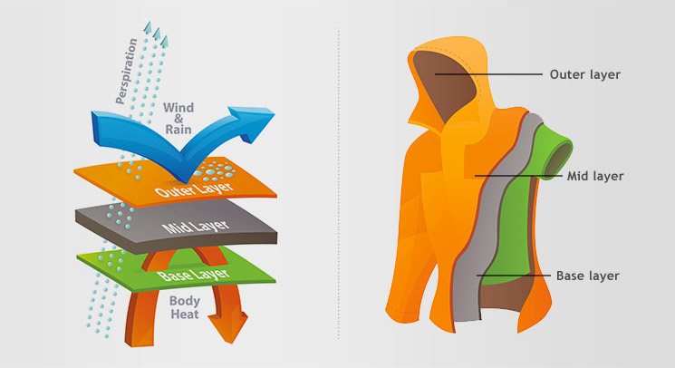
CLOTHING AND LAYERS
Notes:
Base Layer: examples include ‘wicking base layers’, thermal base layers (if you want to keep more heat in), Helly Hanson style base layers etc.
Mid layer: These include fleeces, soft shell jackets etc. Some mid layers can also be water resistant, and wind proof, which make them ideal for days on the hill where rain is unlikely but there is high wind.
Outer layer: The outer layer is the waterproof layer, it is usually thin. These include waterproof materials such as GoreTex.

Slide 5
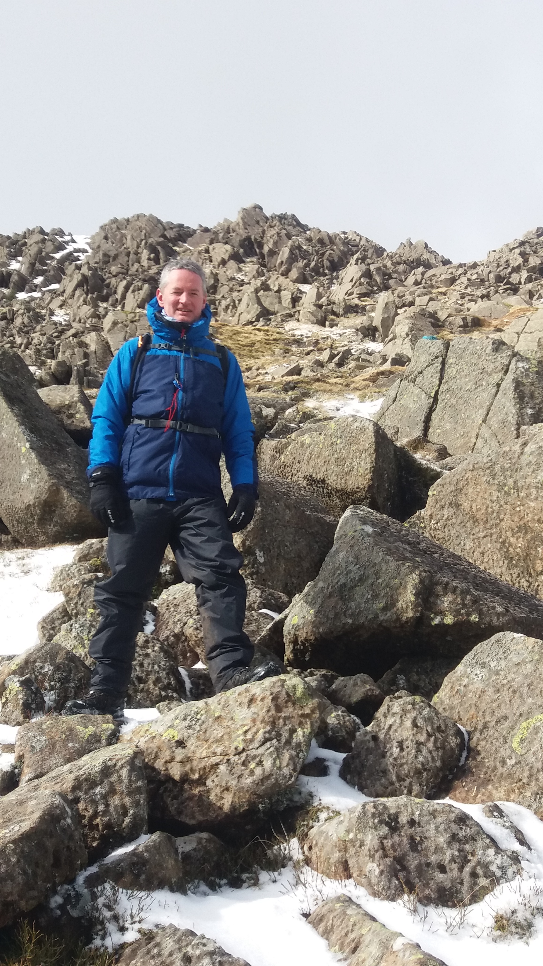
CLOTHING AND LAYERS
Base Layer
Mid Layer
Warm Layer
Waterproof and Windproof Layer
Notes:
This picture was taken going up a mountain in Wales. With the windchill the temperature was -17 Celsius, but I was warm because of the layering system.
Show the following:
Merino base layer top and bottoms, inner gloves, Buff, Hat
Mid-level Fleece
Squadron mid-level fleece
Walking Trousers
Warm Jacket
Gaiters
Waterproof Jacket
Waterproof Trousers
Waterproof Gloves

Slide 6
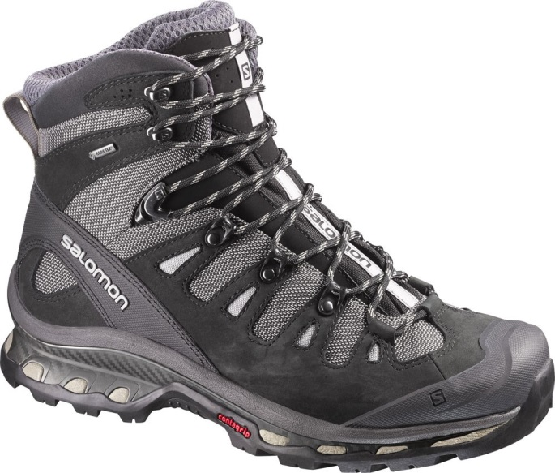
BOOTS
Resource Book
Page 85
Walking boots are an essential piece of kit. Make sure you get the right ones – consult your squadron staff if you need help.
Boots MUST support your ankle, approach shoe style trainers are NOT appropriate.
Wear your boots before your expedition to get them to begin to mould to your foot.
Make sure they fit – try them in store, don’t just blindly buy boots online.
Notes:
Boots generally can’t be issued from squadron so must be purchased.
Must support the ankle – this is due to the additional weight be carried, without ankle support they risk serious ankle injury if they slip with a full expedition pack on their back.
Break boots in by wearing them before hand.
Check they fit, try them on with a sock in store – they can always buy them online later if they know the make, model and size that fits.
You can wear your combat boots for IET and Bronze, but need to be thinking about buying walking boots for Silver and definitely Gold.
Show boots:
Hi Tec Brown boots (£35) and Salomon Quest 4D 3 GTX (£162)

Slide 7
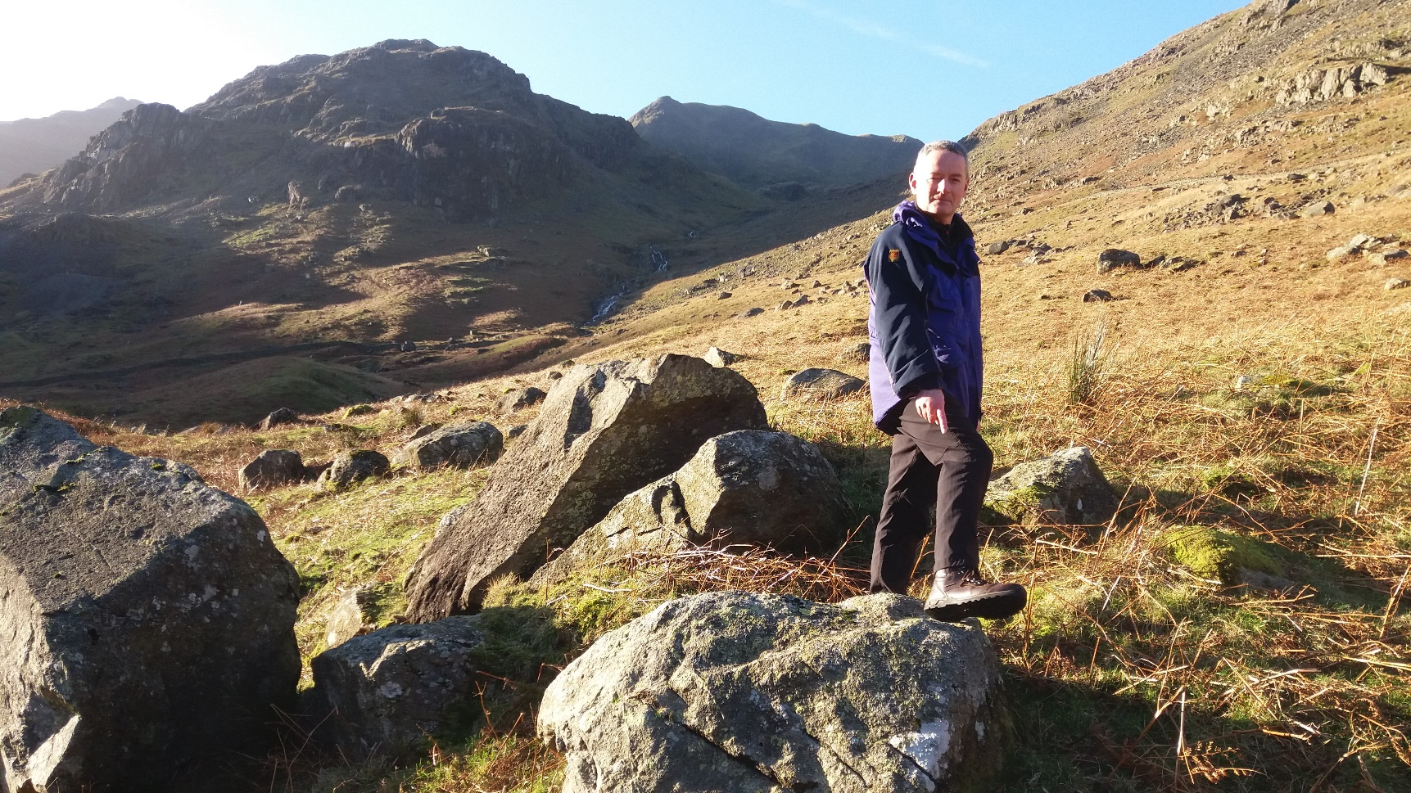
BOOTS
Notes:
This is me on New Year’s Day 2019 half-way up a mountain in the Lake District.
Look at what I’m pointing at.

Slide 8
BOOTS
Notes:
It’s the £35 boots – they are good enough for what you will be doing.

Slide 9
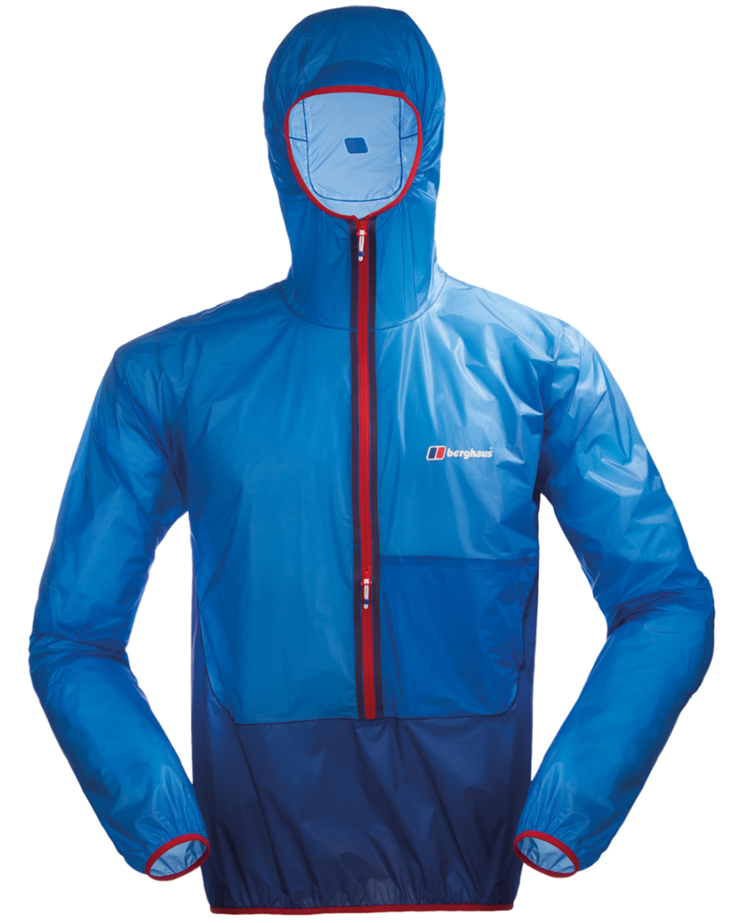
WATERPROOF CLOTHING
Resource Book
Page 85
A good waterproof jacket is important, it protects you from the wind and rain.
Materials like GoreTex are seen as ‘the best’ but cheaper waterproof jackets can be just as good.
Make sure the hood is comfortable.
Make sure you try the jacket on with layers underneath; don’t buy one that’s too small when worn with layers.
Notes:
Military waterproofs should not normally be worn on an expedition.
GoreTex is just a brand, there are other waterproof brands available that work just as well!
Try the jacket on with layers underneath to ensure a good fit.
Show:
My waterproofs and Squadron waterproofs

Slide 10
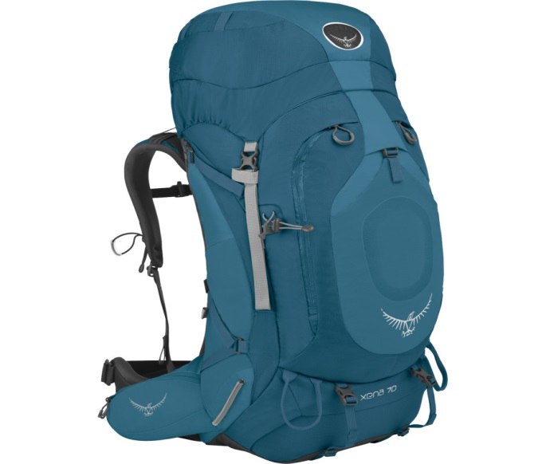
RUCKSACK
Resource Book
Page 86
Make sure that your rucksack is comfortable – most stores will let you try the rucksack with some weight in – this will help you get a feel for how the rucksack will be when it’s got all your kit in.
Make sure the rucksack is at least 65L, any smaller and you may not be able to fit all your kit in.
There are gender specific rucksacks available – these can be more comfortable.
Notes:
A good rucksack must fit well, the better the fit, the more comfortable it will be when carrying a heavy load.
If borrowing a squadron rucksack then get the rucksack issued ahead of time to pack and practice carrying.
Make sure the straps are adjusted and the weight is sitting equally on hips and shoulders – as staff for help as required.
Show:
Squadron rucksack
Male Osprey rucksack
Female Osprey rucksack

Slide 11
SLEEPING BAG
Resource Book
Page 86
A good sleeping bag will ensure you have a comfortable nights sleep while on expedition!
Sleeping bags have a rating to tell you how warm they are, it will either say “3 season” or will state a temperature range. A 3 season bag will be suitable for most expeditions, 4 season bags are designed for winter use and are typically very expensive.
Make sure your sleeping bag has a hood and a ‘mummy’ style bag.
Notes:
Sleeping bag ratings tell them how warm a sleeping bag is:
1 season; Summer use only, very light
2 season: Summer and early autumn/late spring.
3 season: All year except Winter (Required for all cadet activities)
4 season: All year round
Or the sleeping bag will have a temperature rating usually including a comfort rating and extreme rating.
Comfort: means the user will be comfortably warm in that temperature.
Extreme: means the sleeping bag would keep the user alive in that temperature but they would not be comfortable.
Also ensure cadets understand that a mummy sleeping bag is required.
Sleeping systems:
Reflective Mat
Roll Mat
Squadron Roll Mat
Bivi Bag
Squadron Sleeping Bag
Liner
Clothing
Base Layer
Balaclava

Slide 12
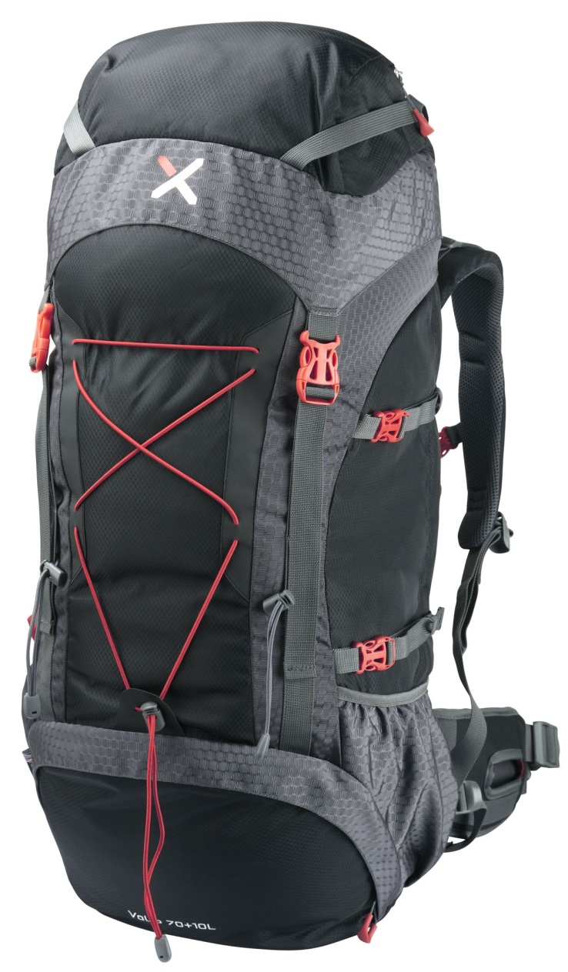
CHOOSING A RUCKSACK
Resource Book
Page 86
When considering selection of a rucksack, consider the following:
Size of rucksack.
Is it gender specific?
Thickness of straps.
Attachment points for equipment.
Notes:
Size of rucksack: cadets will need a rucksack of at least 65L for an expedition in order to accommodate all of their expedition kit.
Is it gender specific: some rucksacks are specific to male or female.
Thickness of straps: thicker straps are more comfortable.
Attachment points for equipment: do you need places to attach tent, roll mat etc outside of the main compartment.

Slide 13
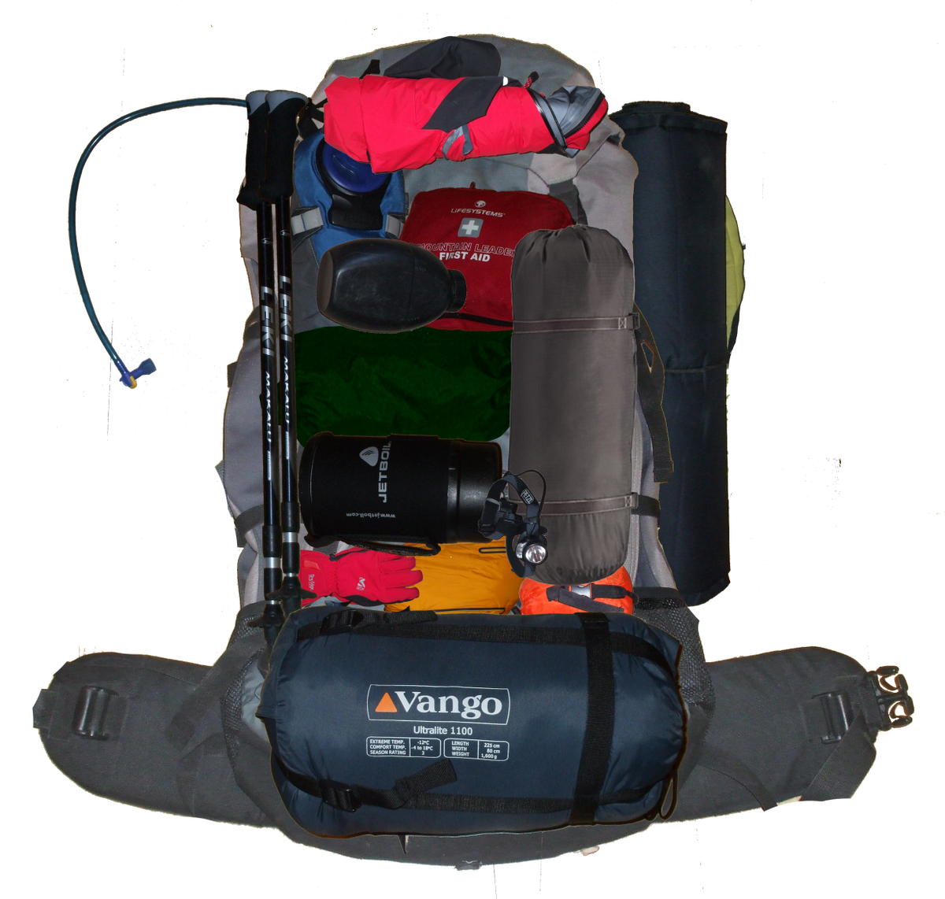
OTHER EQUIPMENT
Resource Book
Page 86
Personal first aid kit.
Roll mat or inflatable mat.
Tent.
Map and Compass.
Notes:
There is additional equipment required. Consult the kit list as issued for full list, this may include:
Personal first aid kit: Including painkillers they would usually take.
Roll mat or inflatable mat: Essential as it provides insulation from the cold ground.
Tent: Appropriate size for the group, pop tents and festival tents are not appropriate.
Map and Compass: Print outs are useful but also take a full OS map for the area you are in.
There should be at least one of these available in the group:
Group shelter
Group first aid kit
Mobile phone
A GPS could also be considered as a tool to use in an emergency. The ‘OS locate’ mobile phone app is a good emergency tool and works even when there is no mobile phone signal.
Handout:
First Aid Kit
Water Bottle / Bladder – min 2 litres
Torch and Spare batteries
Rucksack Liner
Flip Flops/Trainers
Whistle
Food
Plate / Cup
KFS
Towel
Wash Kit
Notepad
Toilet paper
Tent
Stove
Fuel
Cooking Pots
Maps
Map Cases
Compass
Tea Towel
Washing-up Liquid
Rubbish Bags
Storm Shelter
Emergency Food
Spare Boot Laces
Survival/Blizzard Bag

Slide 14
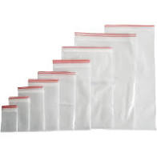
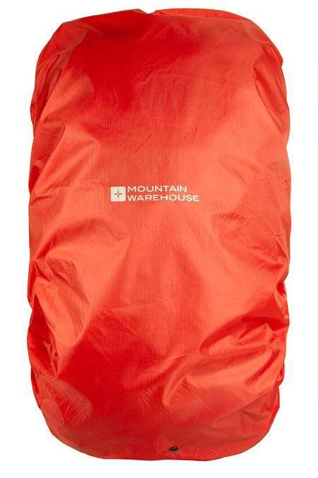
WATERPROOFING
Use ziplock bags to group items together
Plastic liner for inside of rucksack – NOT black plastic bin bags
Waterproof cover for outside of rucksack
Notes:
Group items or days in separate zip-lock bags
Must have a rucksack liner or a thick plastic bag – cannot be a black rubbish bag as they are too thin.
Rucksack Cover

Slide 15
COST?
Notes:
D of E expedition season is April to September – it shouldn’t be sub-zero temperatures
Don’t spend huge amounts on kit as you may not enjoy it.
Everything I was wearing, not including any equipment, costs around £900. But I like doing this kind of thing, so I make sure I am not going to be wearing inadequate clothing.
Squadron can issue the basics.

Slide 16
COST?
Notes:
Pavey Ark, Lake District 1983
You may recognise a face peaking out from behind

Slide 17
COST?
Jumper
Sweatshirt
Charity shop trousers
Notes:
Look at what we are wearing – there is no expensive kit
Normal woollen jumper or sweatshirt
The trousers are woollen trousers cut down, which were bought in a charity shop
The fact that I was there then and here now proves that I survived

Slide 18
COST?
Kit can be issued by the Squadron
You DON’T need to spend huge amounts for Bronze
Silver group need to be thinking about buying walking boots
Notes:
D of E participants receive discounts at these retailers.
The Go Outdoors card costs £5 and you receive huge discounts – this 10% is on top of the Discount Card discount.
If you haven’t started the DofE yet you can go on their website and download a voucher.

Slide 19
COST?
Notes:
If your participation in the D of E will be limited due to the cost then remember that support is always available.
The Squadron’s moto is “Achieve Together”. It isn’t some corporate motivational buzzword. It’s a philosophy.
If you want to do this then you will. And we’re here to help you.

Slide 20
ANY QUESTIONS?
Are there any final questions?
?
Notes:
A chance to ask or answer any final questions.

Slide 21
LEARNING OUTCOMES
LO1: Know how to plan and prepare for safe walking expeditions.
Identify how to prepare expedition equipment and clothing suitable for the walk being planned.
Notes:
LO1: Know how to plan and prepare for a walking expedition.
P4: Identify how to prepare expedition equipment and clothing suitable for the walk being planned.

